Slide 2
Technical Difficulties Check
Muting Rules
Please put any questions into the chat
We will stop for questions regularly!
Notes:
Welcome to d2d
Im Tasnim I’m programmes administrator I’ve helped set up the content and put this all together
If you can hear me that’s great – keep yourself muted
You can ask questions and I will ask questions – reduce background noise
If there are questions you can pop them in chat and I will come back to them
If you can contain it to the end of the section it will help with the flow

Slide 3
Course Objectives
1
2
3
4
Why moving your work online will improve your work
What audience you hope to reach by moving online
How to set up a website and put it on Google so that more people can find you.
How and when to use tools like video calls and social media to engage with the your audience.
Notes:
Go through each stage

Slide 4
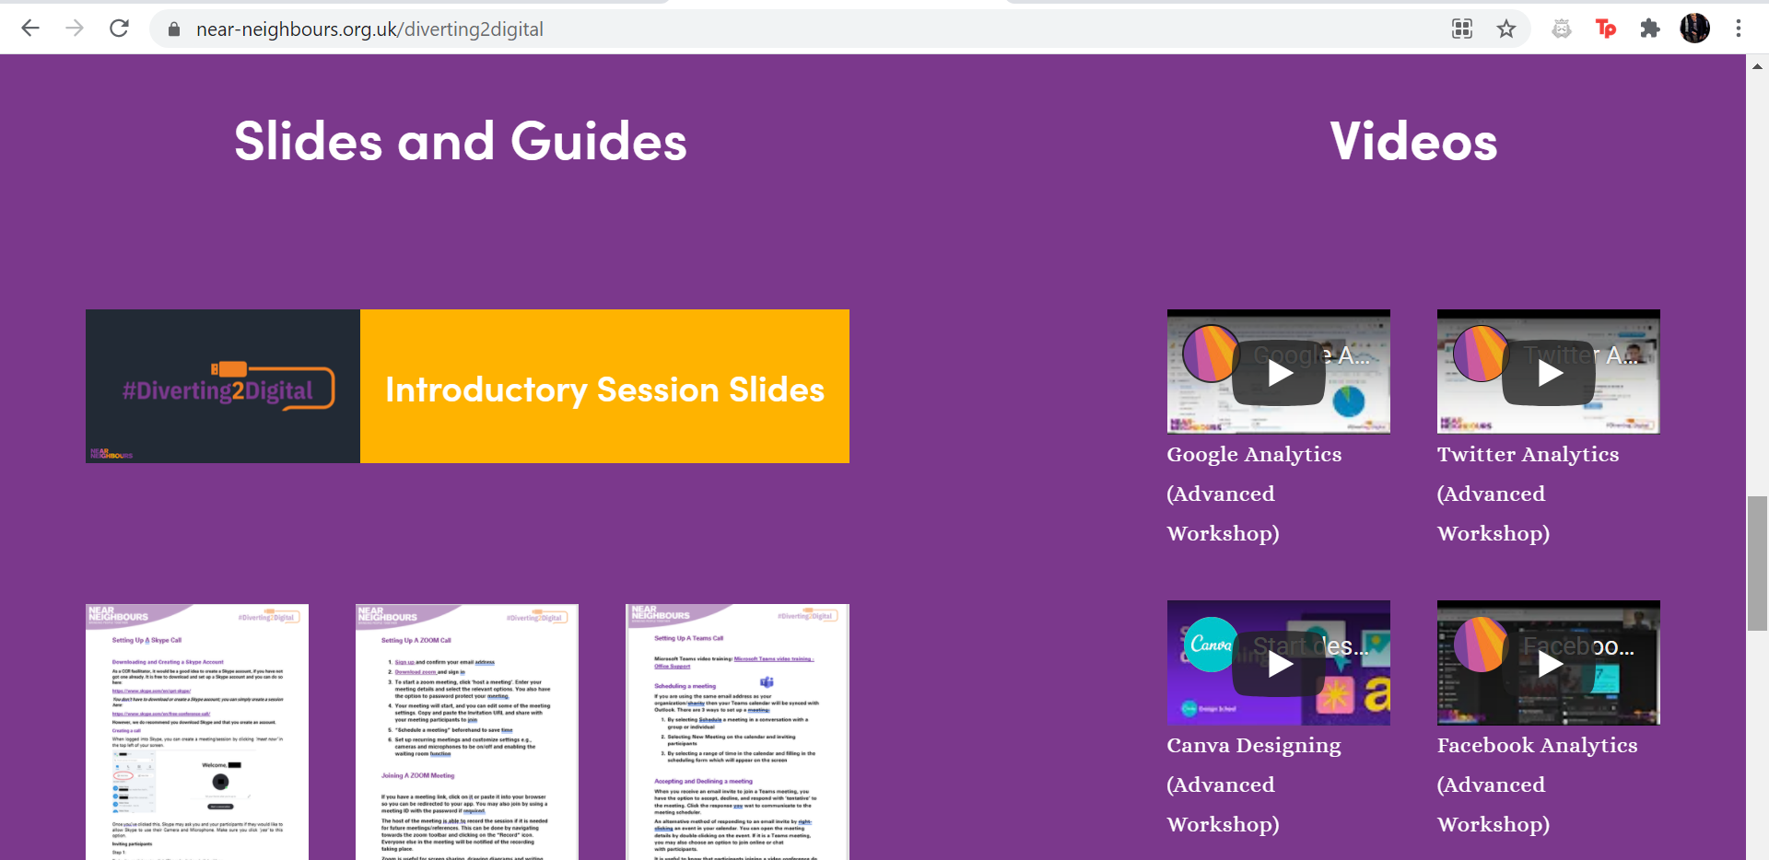
The Diverting 2 Digital Hub
https://www.near-neighbours.org.uk/diverting2digital
Moving Online
Notes:
All the videos and slides are available for free on the d2d hub and the link is here but smita will be sending out an email at the end with the link on
Any questions?

Slide 5
Intentions

Slide 6
Why move online?
Why Move Online?
Engage people from further away than your local area
Stay in regular contact with your customers/users
Find new customers
Find new audiences
Show other people your success
Connect with new local organisations
Support your local community
Notes:
You might wonder why you want to move your business online
Since the pandemic it’s been beneficial to work from home and here are some thoughts of why it might be beneficial, but if you have more then pop them in the chat and we can discuss

Slide 7
Activity: Case Study
Case study: A community singing group has lost contact with some of its members, and is struggling to increase its numbers, since the coronavirus pandemic. How could or should they move online?
Moving Online
Notes:
Case study activity – read it out loud
Pop some examples in that would be relevant for the benefit for moving online
These aren’t all the examples but there might be more than you have thought of
Will show examples of how to use it for your own organisation

Slide 8
Case Study
Case study: A community singing group has lost contact with some of its members, and is struggling to increase its numbers, since the coronavirus pandemic.
How could or should they move online?
They could put the group on Google for free
They could set up a website
They could run ZOOM taster sessions to encourage new members to join, and to be a refresher for those who had not attended the group in a while
They might want to consider having hybrid sessions in order to be inclusive of those who not feel comfortable attending in person
They could set up a Facebook/Twitter/Instagram/TikTok to engage directly with their audience.
Moving Online

Slide 9
Why move online?
What is YOUR reason?
Intentions
Notes:
You might have a motivation of what you have
Hopefully, I can reassure you the benefits of moving online and how you can do that

Slide 10
How do I start?
3 ‘P’s Checklist To Think About Before We Start
Presence
Plan
People
Presence:
Who are you/What is your business? What is your style? Serious, artsy, fun, convenient, informative?
Plan:
What is your aim of your message? Which platform is best to deliver it?
People:
Who is your audience? What do they look for?

Slide 11
How long do you think it will take me to show you how to set your organization up on Google?

Slide 12
Set up my business/charity on Google
Moving Online
Notes:
https://youtu.be/muwk3gGqUZ4

Slide 13
Video Conferencing

Slide 14
ZOOM Walkthrough + Q and A
Moving Online
Notes:
We use this vide as a reference point because it would be difficult to explain to someone who has set one up.

Slide 15
Video Conferencing
How to use Zoom:
How to use Skype
How to use Microsoft Teams
Moving Online
Notes:
Zoom became big throughout the pandemic. Skype is also a good video conferencing tool as well as Teams. Zoom has a free account and there is a limit of 40 minutes, but you can have paid for accounts also
Skype is good for 1-2-1 sessions
Team is a good business based one

Slide 16
Activity: Bad Video Call Behavior
What examples of bad video calling behaviour can you see?
(Please feel free to list them in the chat)
Moving Online
Notes:
You can pop in the chat what bad behaviour is

Slide 17
Tips for Video Calls
Mute your microphone unless you are speaking
If your internet connection is poor or lagging, turn off your video so that your audio is clearer or use the chat function
Ensure your devices (laptop, mouse, headphone, mic, etc.) are working before staring your meeting.
Moving Online
Notes:
Reducing background noise and distractions (point 1)
Read through the rest of the points

Slide 18
Responsible Video Conferencing
Assess the risks of any online gathering just as you would for an in person gathering! You are still responsible for vulnerable people even if you aren’t sharing a room with them.
Moving Online

Slide 19
Sample Risk Assessment
What are the hazards? | Who might be harmed and how? | What are you already doing? | Do you need to do anything else to manage this risk? | Action by whom? | Action When? | Done?
Unknown people attending meetings | Young people in meetings whose identity may be exposed to unknown people | Using passwords for meetings | Avoid making passwords publicly available Use Zoom’s waiting room feature Lock meetings when all invitees are in Only allow people in the meetings who are using their cameras | Youth leader/ meeting leader | Immediately
Moving Online
Notes:
You can use this table and pop in the risk and follow it through (go through the table)
You might not want them to have their camera on the whole meeting but when they say hello only to verify things
Follow the risk assessment through to make sure you minimize risks

Slide 20
Safeguarding Video Conferences
Why might these suggestions be important?
Avoid, limit, or prohibit 1:1 video conferencing with vulnerable people
End the call if you hear/witness something concerning, follow safeguarding procedure
Have a specific dress, language, and behaviour code to match normal work standards
Avoid recording calls as they require full consent, which can be withdrawn at any time
Removing any participants who are not following these guidelines
Using the waiting room option to control who enters the meeting
Not advertising the meeting ID or password
Agreeing when and where meetings will happen in staff homes
Moving Online
Notes:
Safeguarding video conferences – why might these suggestions be important?
Go through the points – these would apply as and when you see fit

Slide 21
Social Media
How and when to use tools like video conferencing and social media to engage with the your audience.

Slide 22
Why did we select these platforms?
Social Media

Slide 23
Who is reached by each platform?
Social Media

Slide 24
Make it clear the 4 platforms reach different people
Great for targeting older groups
Great for holding and advertising events
Great for keeping in touch with small groups, charities and organisations
Great for engaging with people far and wide
Good place for consistent posting
Very visual (picture based) – great for advertising products or services
Great for targeting younger groups
Also, very visual (video based)
Great for targeting younger groups and learning about new trends
Social Media

Slide 25
Vocabulary for Social Media
URL: A URL is a website link such as www.near-neighbours.org.uk. Shorten via websites such as bitly.com
Audience: Those you’re already engaging with AND those you want to engage with.
Blog: Regularly updated web page, typically run by an individual or small group that is written in an informal or conversational style.
Newsfeed: Physical webpage where you view posts from other people and where most social media engagement takes place. Sometimes referred to as a “feed”.
Social Media
Notes:
Bitly: I will reference this later but twitter has a character count so if you want to post links, go on this and shorten the link you’d like to reference to

Slide 26
Facebook
Facebook is like a cork board
Share information that audience will read passively
Great to share flyers and information about events
Equally used for text and images
Longer form entries are fine – there’s no wordcount!
There is a HUGE audience base!
Who: 30 million UK mobile users each day
What: quick and easy to engage with content, more about absorbing than interacting
Where: worldwide, heavy UK use
When: Post once a day to start
How: Set up a page, invite people, use insights, allow others access to control page
Social Media
Notes:
Go through the points
Others in the organisation can use the facebook page
There is a diverse age bracket
Show them what a regular page and post looks like

Slide 27
Facebook
https://www.facebook.com/nearneighbours/
Social Media

Slide 28
Facebook Vocabulary Checklist
Facebook Page: What organisations use to represent themselves on Facebook. Different from a ‘profile’.
Tag: A social media name preceded by the @symbol. The @ turns the name into a link. Others can click to their page/profile through your post.
Share: To take a post from a Facebook page that is not your own and post it on your own page so your followers can also see it. The original poster is given credit in the sharing process.
Like: Showing someone you like their post with a specific button
Message: A private message that is only visible to the sender and the recipient. Posts that are not messages on Facebook are public!
Social Media
Notes:
E.g. if a person on NN wants to tag church urban fund they would @ and it would show up
If your org focuses on something specific and you see a news article you can show that through the BBC news Facebook page but it would still credit BBC so a user would be able to go to the original page
Someone might want to contact you through Facebook – if it’s on the posts then it is public

Slide 29
Twitter
https://twitter.com/nearneighbours?ref_src=twsrc%5Egoogle%7Ctwcamp%5Eserp%7Ctwgr%5Eauthor
To ‘tag’ in a tweet, don’t start with just a handle
Only people follow both of you will see it.
Try starting with a dot, like this: .@nearneighbours
All followers of both accounts see the tweet.
Social Media
Notes:
Show them what a news feed looks like
Show them the trends on the side and what it mean

Slide 30
Twitter
Who: 12.6 million UK users: politicians, faith leaders, academics, businesses, local activists
What: slightly more serious hub for interactions and conversations
Where: national and international
When: tweet multiple times a day
How: follow others, use ‘hook’ or picture, max 280 characters, #hashtag, like, retweet, reply
Why Choose Twitter:
Share your views or ideas: twitter responds to clear opinions (be careful if it’s a work account!)
Generally text based – limited use of images
Great for customer service or interacting with audiences
Use hashtags to discover opinions and views of others
Follow influential members of your community to hear their thoughts
Social Media
Notes:
Under half of the users of facebook use twitter in the UK
You can do a thread if there are a couple of updates but maybe only the first tweet might show on the feed
Hashtag – trending conversation or you can create your own hashtag
You can retweet someone else whilst giving them credit and showing it on your profile
Make sure that you are tweeting what is appropriate

Slide 31
Twitter
Tweet: A Twitter post, no more than 280 characters allowed.
Handle: The name by which you are known on Social Media, including ‘@’ at the start. Use handles to tag people or groups in to your social media posts.
Retweet: Similar to Facebook “share”, allows you to tweet somebody else’s tweet to your followers. Be careful not to retweet things you don’t agree with. Sometimes shortened to ‘RT’.
Hashtag: Tool that allows you to tap in to a conversation that is happening. Use
a # at the start of a word or phrase.
Near Neighbours wants people to talk about Inter Faith, so we asked people to tweet using #lnterFaithMeans. It is then possible to search #lnterFaithMeans and see what people are tweeting.
Social Media
Notes:
Hashtag – trending conversation or you can create your own hashtag
You can retweet someone else whilst giving them credit and showing it on your profile
Make sure that you are tweeting what is appropriate

Slide 32
Instagram
https://www.instagram.com/nearneighbours/?hl=en
Social Media
Notes:
Mobile based app
The desktop isn’t efficient to use and it’s mainly for mobile use
It’s better to do the posts once a day because more consistent posting means you’ll be more active on people’s newsfeeds because of the algorithms

Slide 33
Instagram
Who: 16.7 million monthly active users in UK, largely young people
What: format entirely based around colourful images, option to include text
When: regular, consistent posting is more important than how often
Where: 700 million global monthly users
How: stay active, share events in real time, follow others & like posts, use home tab
Social Media
Notes:
Instagram stories – you can share events in real time through stories that are only up for 24 hours and then you can post throughout an event rather than spreading it across
Instagram filters show so that you’re not misleading anyone

Slide 34
Instagram
Influencer: people who have built a reputation for knowledge and expertise on a specific topic. Their regular posts generate large followings of enthusiastic, engaged people who pay close attention to their views.
Filter: a photographic filter users can apply to their photos
Direct Message: a private photo sent to another Instagram user
Social Media

Slide 35
TikTok
https://www.tiktok.com/
Social Media

Slide 36
TikTok
TikTok is similar to Instagram, where you can follow people to see their posts, whilst also having a For You page where you can see posts similar to those that you like.
Instead of photos, people post videos, with a maximum length of 3 minutes. People post about a range of topics, from comedy to cooking to dance to informative videos.
Many big brands and companies now have TikTok accounts, as it allows them to interact with a younger audience, and engage with them directly.
Social Media

Slide 37
TikTok
Who: 12 million monthly active users in UK, largely young people
What: Format based around short videos on any topic
When: Regular, consistent posting is more important than how often
Where: 100 million global monthly users
How: Stay active, post videos, like and comment on other users’ posts
Social Media

Slide 38
TikTok
Influencer: Same as Instagram - people who have built a reputation for knowledge and expertise on a specific topic. Their posts generate large followings of enthusiastic, engaged people.
For You: A page where videos are suggested for you by TikTok based on other videos/accounts you have liked or followed in the past. Different to you Following page which will just show vidoes from accounts that you already follow.
Sound: Sounds can trend on TikTok. These are often short audio clips that people play in their videos that all focus around a certain theme/joke etc. Song clips can also become very popular on TikTok, with many accounts using them in their videos.
Social Media

Slide 39
Break

Slide 40
Creating Content

Slide 41
What is Canva?
So, you have set up your Facebook, Instagram or Twitter and now want to start posting branded content?
Images and videos are a great way to keep followers/users updated, but branded images and designed content help to strengthen your organisation/groups brand further
Canva is a free image and video editing tool, and it couldn’t be easier to use!
You can sign up for free and it can be shared by multiple users
There are numerous templates and layouts to harness
QUICK TIP:
If you have a logo, putting it on all your images makes them instantly recognisable to your organisation/group. You can then put this on all your content, including your newsletter!
Creating Content
Notes:
Slide 22
Read off the slide
There are so many templates and layouts but you can also start from scratch
It’s good to keep branding in everything that you create

Slide 42
Setting Up Canva
ADDITIONAL LINKS:
Starting to design
Editing
Sharing
Creating Content
Notes:
Slide 23
Setting up canvas video

Slide 43
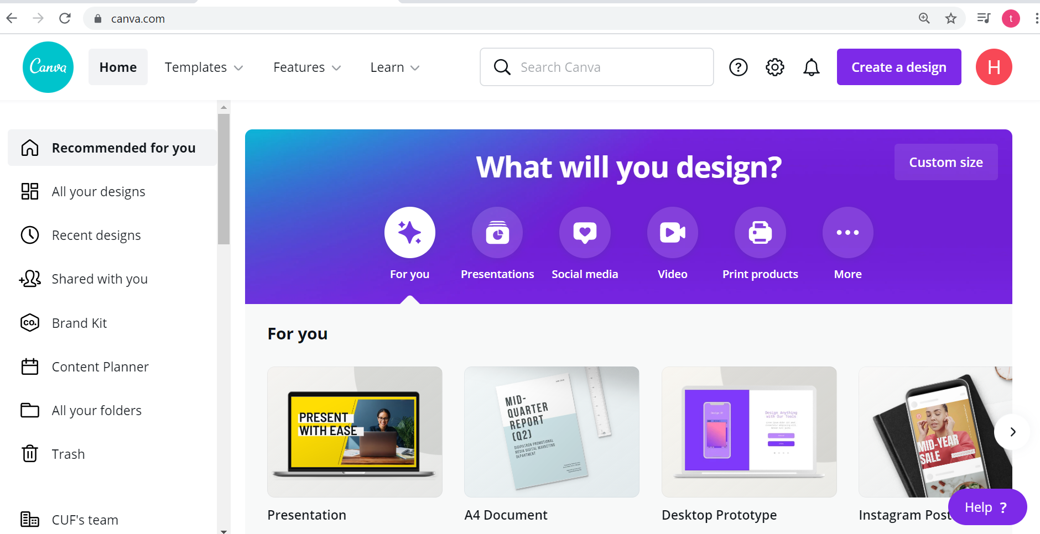
Canva Walkthrough
Creating Content
Notes:
Slide 24
Canva walkthrough of setting up a new page, selecting a template/existing design and how to upload a logo/picture.

Slide 44
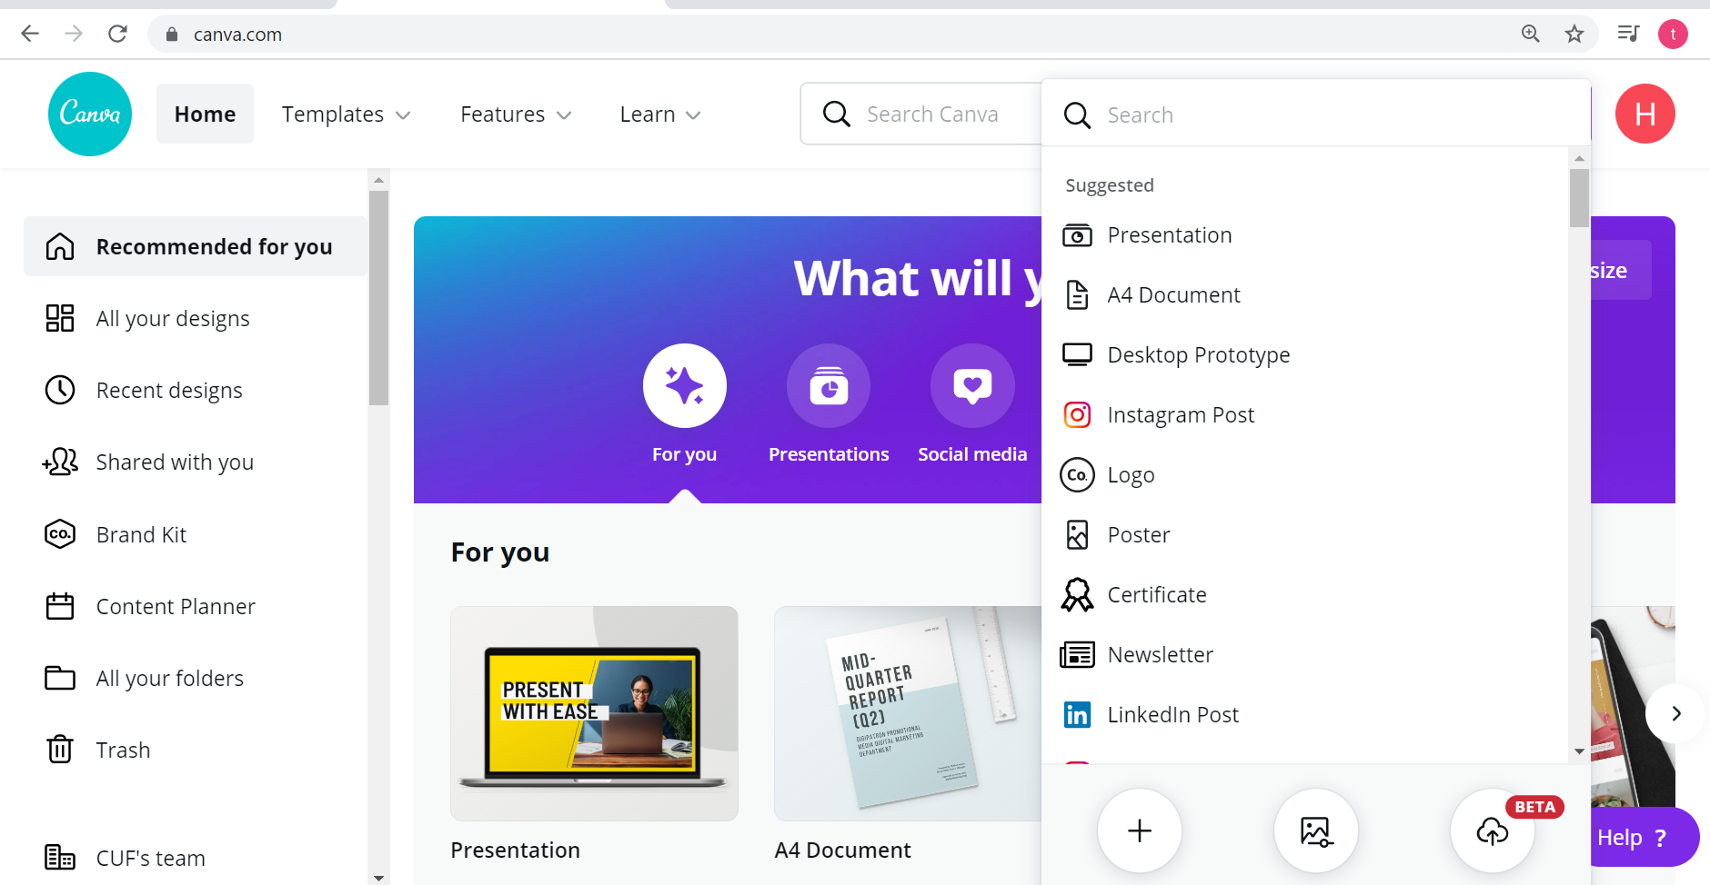
Canva Walkthrough
Creating Content
Notes:
Slide 24
Canva walkthrough of setting up a new page, selecting a template/existing design and how to upload a logo/picture.

Slide 45
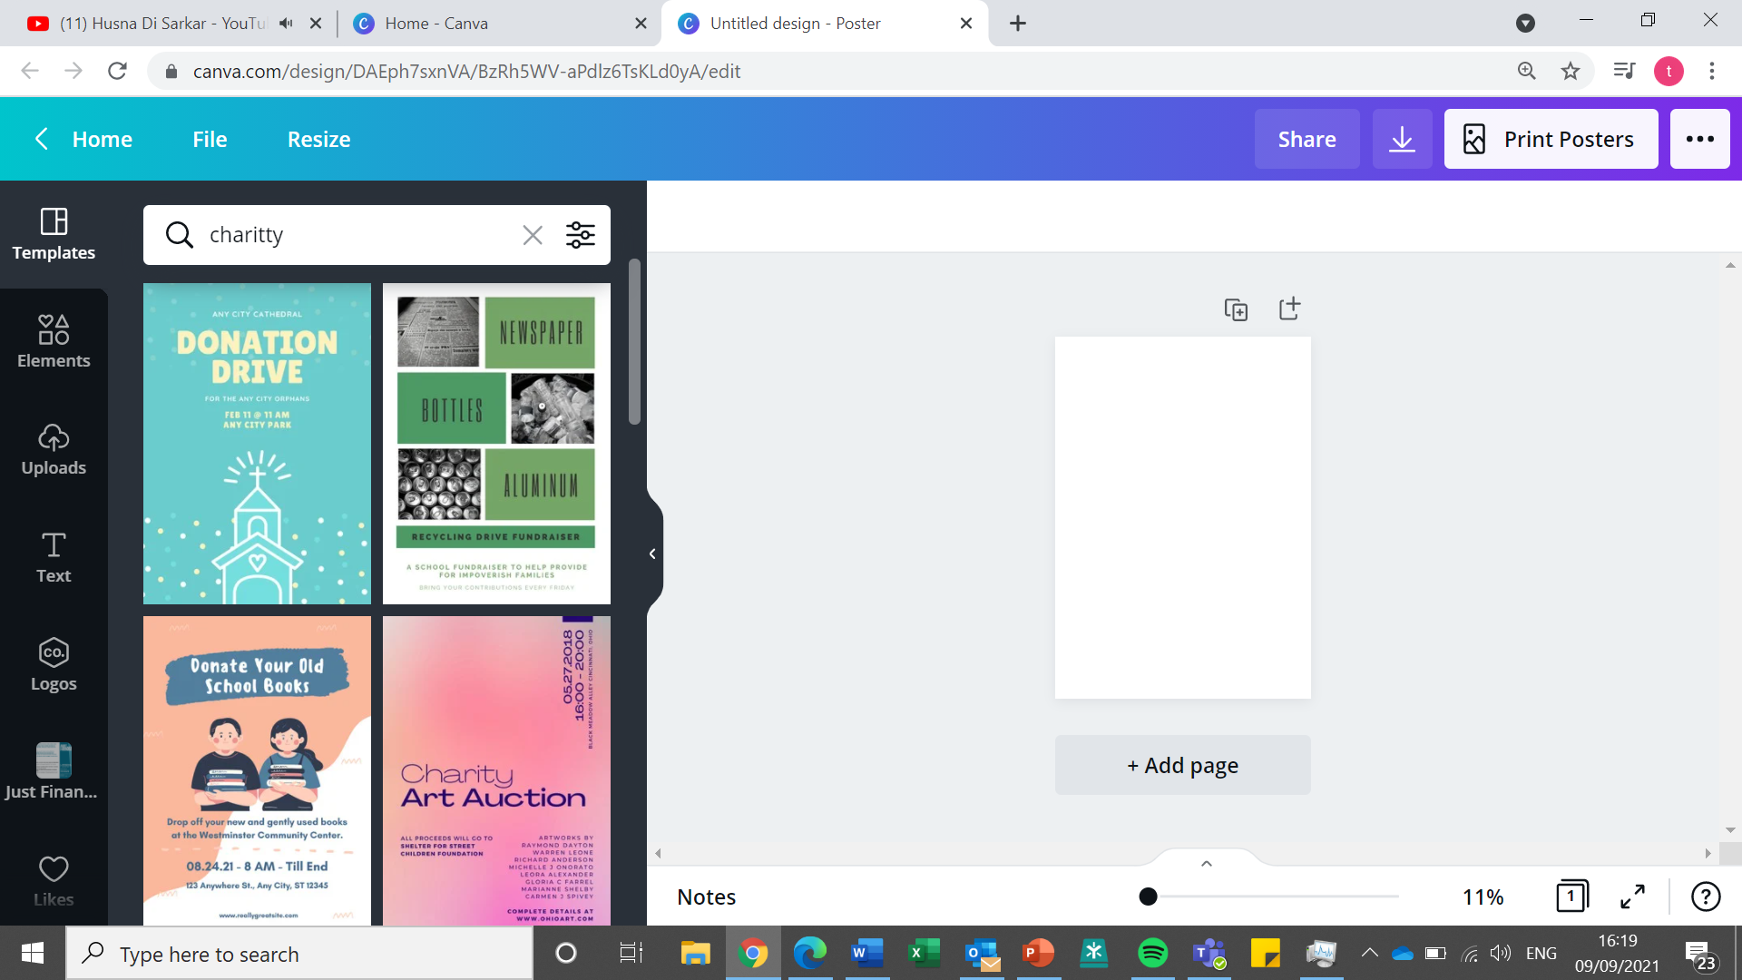
Canva Walkthrough
Creating Content
Notes:
Slide 24
Canva walkthrough of setting up a new page, selecting a template/existing design and how to upload a logo/picture.

Slide 46
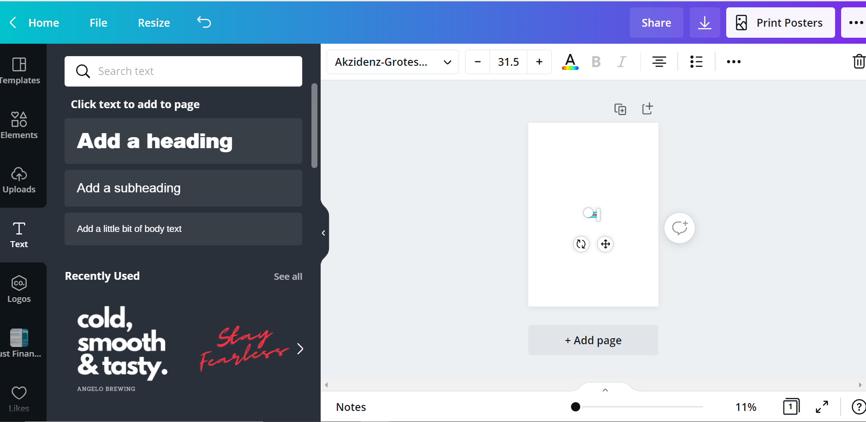
Canva Walkthrough
Creating Content
Notes:
Slide 24
Canva walkthrough of setting up a new page, selecting a template/existing design and how to upload a logo/picture.

Slide 47
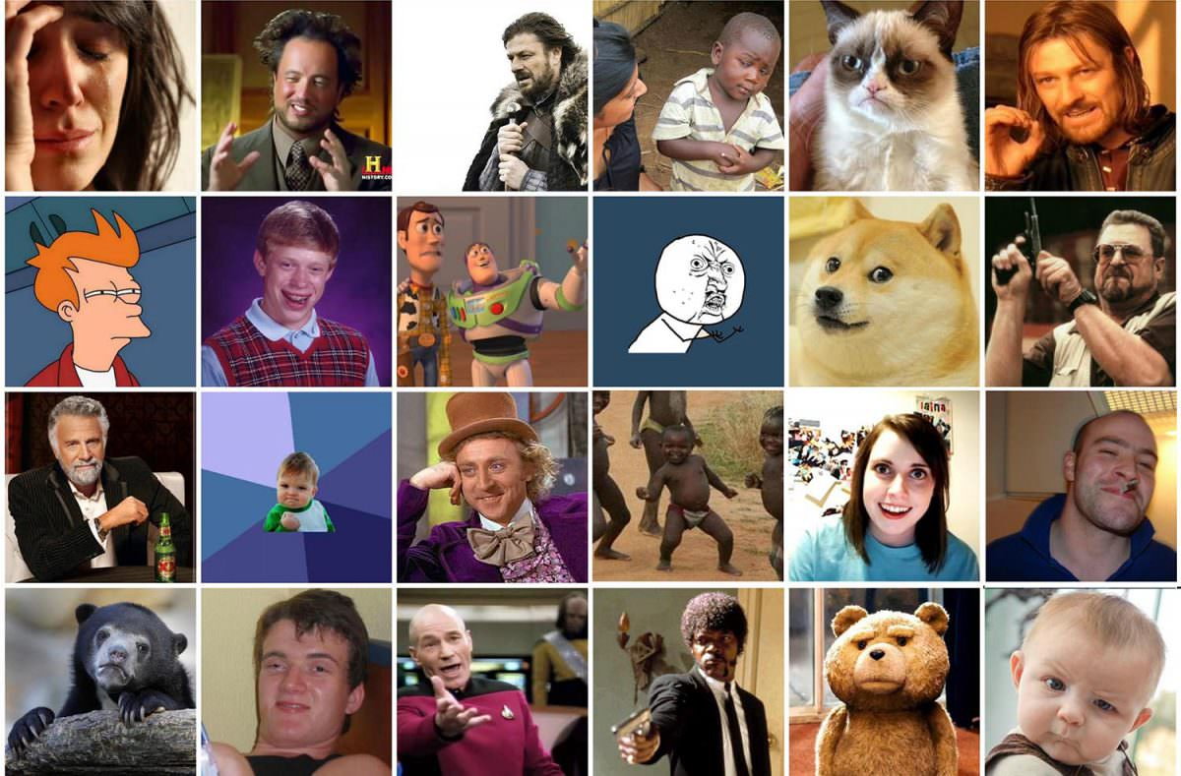
Introducing Internet Memes
Have you seen any of the below images before: if so, where?
Notes:
Have you seen any of the below images before: if so, where?

Slide 48
Introducing Internet Memes
An Internet meme, more commonly known simply as a meme, is an idea, behavior, or style that is spread via the Internet, often through social media platforms and especially for humorous purposes. What is considered a meme may vary across different communities on the Internet and is subject to change over time.
Internet memes are considered a part of Internet culture. They can spread from person to person via social networks, blogs, direct email, or news sources.
What do you Meme?
Notes:
An Internet meme, more commonly known simply as a meme, is an idea, behavior, or style that is spread via the Internet, often through social media platforms and especially for humorous purposes. What is considered a meme may vary across different communities on the Internet and is subject to change over time.
Internet memes are considered a part of Internet culture. They can spread from person to person via social networks, blogs, direct email, or news sources.

Slide 49
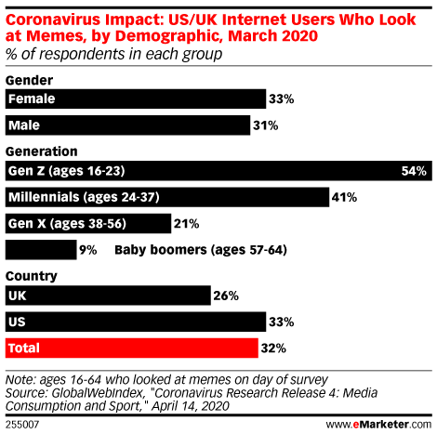
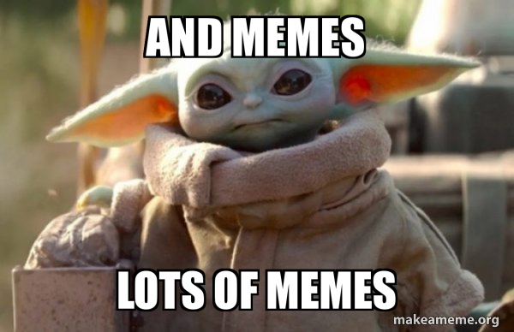
Introducing Memes
55% of 13-35-year-olds send memes every week—and 30% send them every day.
74% send memes to make people smile or laugh—and 53% send them to react to something.
Notes:
55% of 13-35-year-olds send memes every week—and 30% send them every day.
74% send memes to make people smile or laugh—and 53% send them to react to something.

Slide 50
Memes & Marketing
Notes:
Very UK – pug in socks

Slide 51
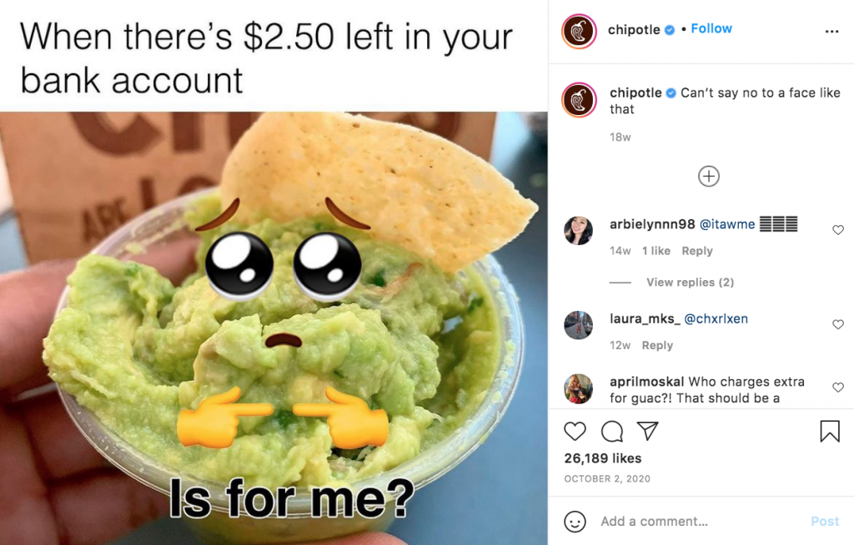
Memes & Marketing
Notes:
Chipotle – guacamole

Slide 52
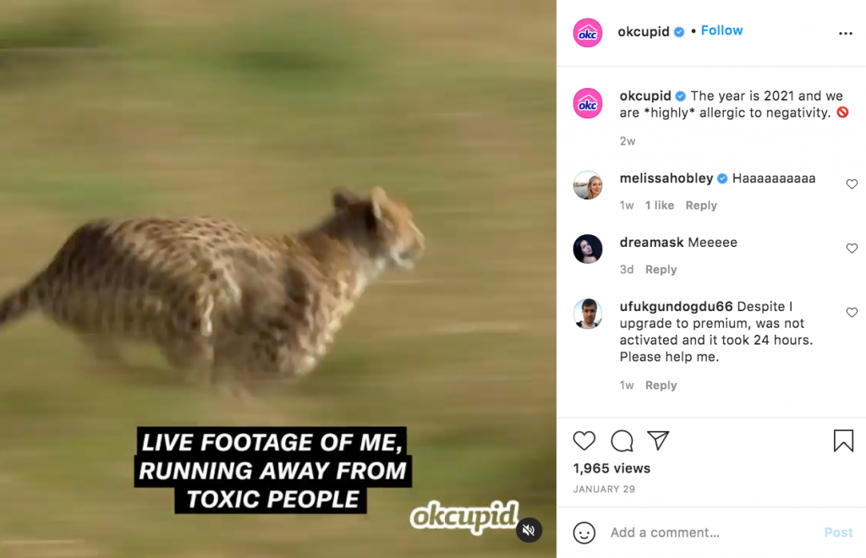
Memes & Marketing
Notes:
OK cupid

Slide 53
Using Memes – Pro’s & Con’s
What do you think are some of the Pro’s and Con’s of creating and using memes on your social media channels?
Pro’s | Con’s
It is a fun way to engage with your audience. | Humor is subjective, to reduce the likelihood of things being taken the wrong way you need to think carefully about what you post and how it might be interpreted.
It can make your brand appear relatable and it is a good way of sharing your values. | There is a risk that some of the variations of the meme are, or in the future will not be, not in-line with your values. You can reduce the likelihood of this by keeping things simple and staying away from anything that could be deemed controversial, unless that is your intention.
There is a potential to get your post noticed and shared. | You need to know your audience and their culture, if incorrectly targeted you might lose followers.
You can make your posts more memorable. | It is not always appropriate, and you need to consider the wider political and socio-economic climate as well as the purpose of the post.
Notes:
Pro’s
It is a fun way to engage with your audience.
It can make your brand appear relatable and it is a good way of sharing your values.
There is a potential to get your post noticed and shared.
You can make your posts more memorable.
Con’s
Humor is subjective, to reduce the likelihood of things being taken the wrong way you need to think carefully about what you post and how it might be interpreted.
There is a risk that some of the variations of the meme are, or in the future will not be, not in-line with your values. You can reduce the likelihood of this by keeping things simple and staying away from anything that could be deemed controversial.
You need to know your audience and their culture, if incorrectly targeted you might lose followers.
It is not always appropriate, and you need to consider the wider political and socio-economic climate as well as the purpose of the post.

Slide 54
Meme - Cheers

Slide 55
Websites

Slide 56
Why make a website?
Why is it a good idea to have a website??
Websites
Notes:
Take then through the spider diagram

Slide 57
Why move online?
Why have a website?
Reach people from further away than your local area
You can update your customers/users
You might sleep but your website does not! People can find you 24/7!
Find new audiences
Show other people your success
Makes your organisation appear professional
Sell or advertise you products or services

Slide 58
Domains
What is a Domain name?
Let’s see if your organisation's name is free!
Go Daddy Domain Name Checker
This is your business/charity web address. Customers will type this address in the search bar e.g:
www.tesco.co.uk
www.amazon.com
www.petsathome.co.uk
www.moneysupermarket.co.uk
Websites
Notes:
Domains and key vocabulary – searching the news etc through google

Slide 59
Key website vocab
Domain | A website’s equivalent of a physical address. Like how a GPS uses a postcode, a web browser needs a domain name to direct to a website. Nearneighbours.org.uk
URL | A unique web address to identify a specific place or webpage. https://www.near-neighbours.org.uk/about
Content | The text and images displayed by a website. Content is distinct from a website’s layout and styling; layout and style are used to present content in the desired way.
Navigation | The main links which let users move around a website, sometimes called “menus”.
Websites

Slide 60
Website Set Up Options
Squarespace
Very easy to use
Can sell items too
Costs £10-£15 a month
Go Daddy
Very user friendly to use
Cheap
Site123
Straightforward and User friendly
Minimal customization options
Very simple to set up
Wordpress
Offers the most customization
Great if you want to be creative and love design
So many options can be overwhelming
Websites
Notes:
Squarespace is simple to use
Wordpress is more of a blog and it offers the most customisation. It gives so many options and it can be a bit overwhelming
The other two also have benefits of their usage

Slide 61
Squarespace: Set An Account Up
Websites
Notes:
Squarespace walkthrough

Slide 62
What If I Just Want To Sell Things
Sellers handbook available
Customers leave reviews and product ratings on your shop page
Payments through PayPal
Edit your shop layout when needed
Multichannel selling through Facebook and Instagram
Create newsletters for your customers
Websites
Notes:
Etsy – can set up a page really quickly and customers can leave reviews and product ratings
Wix – you can sell through fb and IG and you can create newsletters

Slide 63
Next Steps Checklist
Questions?

