Slide 1



Slide 2

Technical Difficulties Check
Muting Rules
Please put any questions into the chat
We will stop for questions regularly!
Notes:
Slide 2
Welcome to d2d
Introduce yourself
If you can hear me that’s great – keep yourself muted
You can ask questions and I will ask questions – reduce background noise
If there are questions you can pop them in chat and I will come back to them
If you can contain it to the end of the section it will help with the flow

Slide 3






Workshop Structure
Creating
Content
Branching
Out
Advanced
ZOOM
Analytics
Social media Analytics
Google Analytics
SEO
Canva
Mailchimp and Newsletters
Scheduling Social Media Posts
Surveys
Online Fundraising
Engaging with others
Breakout Rooms
Polls
Notes:
Slide 3
4 course objectives that flow into each other
Go through each stage

Slide 4
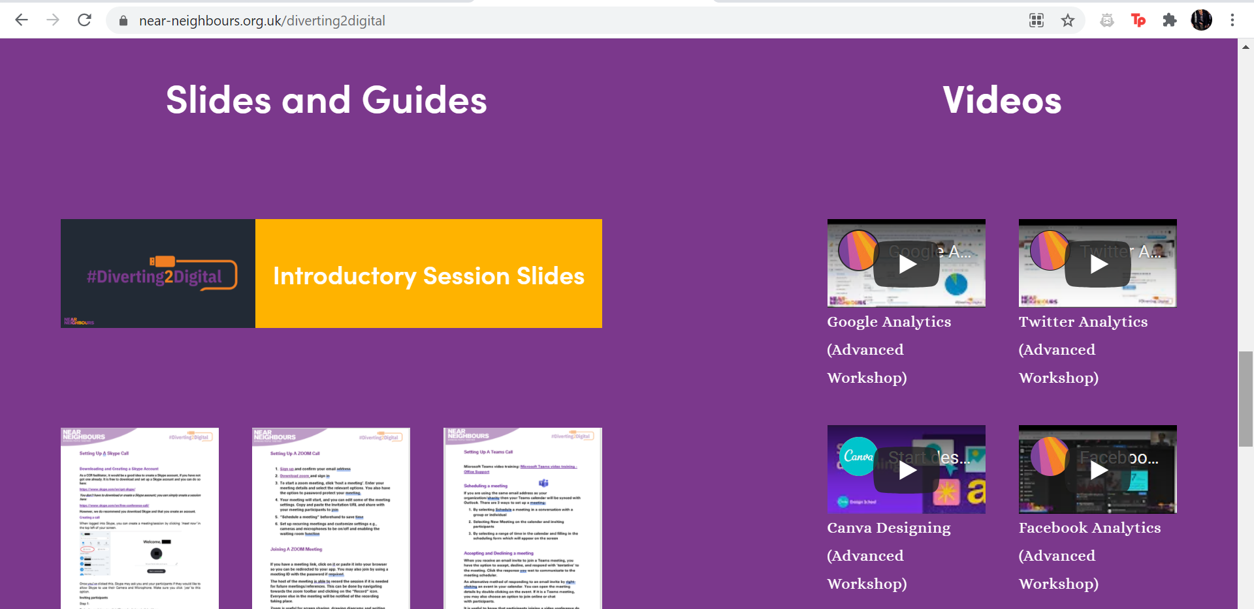
The Diverting 2 Digital Hub
https://www.near-neighbours.org.uk/diverting2digital
Notes:
Slide 4
All the videos and slides are available for free on the d2d hub and the link is here but smita will be sending out an email at the end with the link on
Any questions?

Slide 5
Analytics
Notes:
analysis of data or statistics.

Slide 6
Analytics
Digital analytics
Digital analytics is the process of analysing digital data from various sources like websites, mobile applications, among others.
Social media analytics
Social media analytics is the process of tracking, collecting and analysing data from social networks.
Metrics
A system or standard of measurement.
Social media listening
Social listening applies to one specific aspect of social media analytics: Learning about your audience.
Analytics
Notes:
Slide 7
There are several reasons to use Social Media analytics (go through the points on the slide)

Slide 7
Analytics
A small charity has just completed a month-long social media campaign with the aim of encouraging individuals to visit their website and gain awareness of their cause.
Activity: In breakout rooms, as a member of the marketing team what metrics might want to look at when reviewing the effectiveness of this campaign.
Clicks
Comments
Shares
Video views
Follows
Links clicked
Audience Growth Rate
Average Engagement Rate
Cost-Per-Click (CPC)
Post rate
Comment rate
Pageviews
Traffic
Direct visitors
Search visitors
Referral visitors
Bounce Rate
… & many more
Analytics
Notes:
Slide 7
There are several reasons to use Social Media analytics (go through the points on the slide)

Slide 8






Social Media Analytics
Why can it be a good idea to use Social Media analytics?
It helps you to post with purpose (have a clear goal or reason for posting)
Improves your content
Boost followers
Learn more about who your audience are
Learn more what your audience likes
Increase user/follower engagement
Analytics
Notes:
Slide 7
There are several reasons to use Social Media analytics (go through the points on the slide)

Slide 9
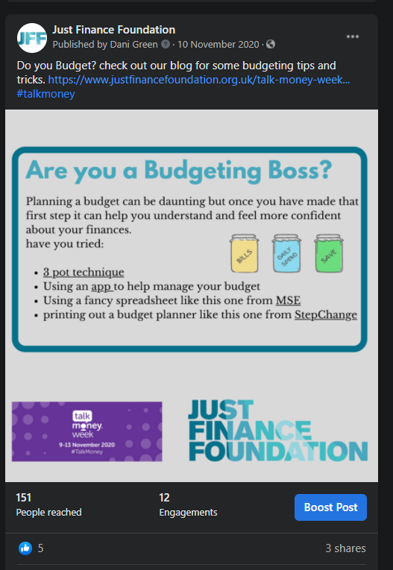
Facebook Analytics
Introducing Social Media Analytics
The best way to use begin effectively using Social Media analytics is to check if you are successful in posting with purpose.
ACTIVITY: Was this post successful?
1) What was the goal/purpose of this post?
2) What did we specifically want our audience to do?
Analytics
Notes:
Slide 8
We’re going to start off with an example and you might not understand it all but it’s to show you how you can do things differently
Here we see a Facebook post providing some information on budgeting techniques. What do you think is the goal and purpose of the post, and what do we want our audience to do? Feel free to unmute yourself or use the chat to share your ideas.

Slide 10
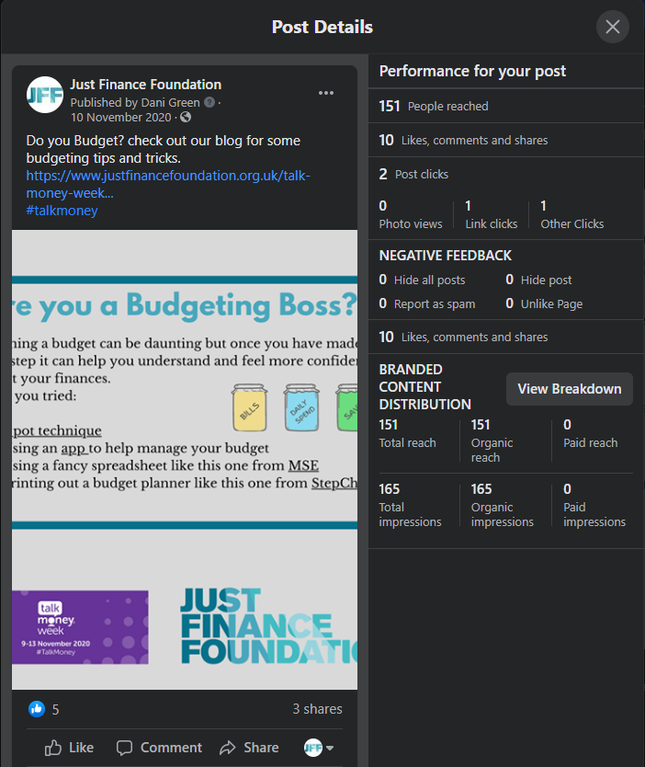
Facebook Analytics
Was the post successful in achieving the goal of getting followers to view our blog?
What metrics do we need to look at?
KEY POINT: although a post may have a lot of likes and shares, it may not be achieving what you want it to. Facebook Analytics can help you understand this.
Analytics
Notes:
Slide 9
In your opinion now do you think this post was successful, remember to keep in mind the purpose of the post and what we want the audience to do. – let participants answer
Look at the metrics – it only had one link click – it didn’t meet the target. That isn’t considered successful.
The whole point of this is to understand how successful your organization is on Facebook and what types of posts are more successful than others

Slide 11

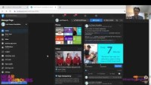
Facebook Analytics Walkthrough
Analytics
Notes:
Slide 10
Facebook video – play a bit of the video and then say there’s not enough time to play but they are all available on the hub

Slide 12
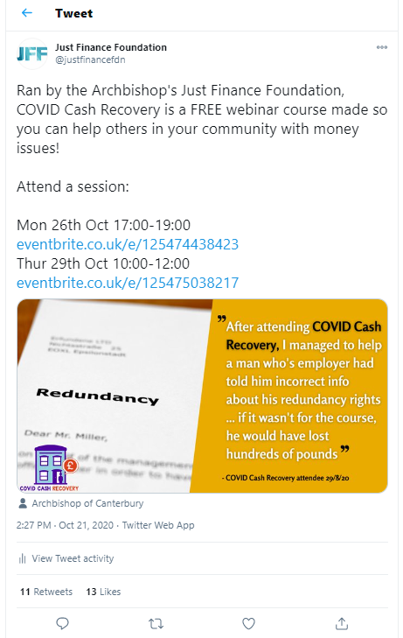
Twitter Analytics
ACTIVITY: Was this post successful?
1) What was the goal/purpose of this post?
2) What did we specifically want our audience to do?
Analytics
Notes:
Slide 11
Twitter analytics
On the left hand side we have a tweet from JFF
In your opinion now do you think this tweet was successful, remember to keep in mind the purpose of the post and what we want the audience to do. – let participants answer
Do another zoom poll and they can talk about the other ones if time allows

Slide 13
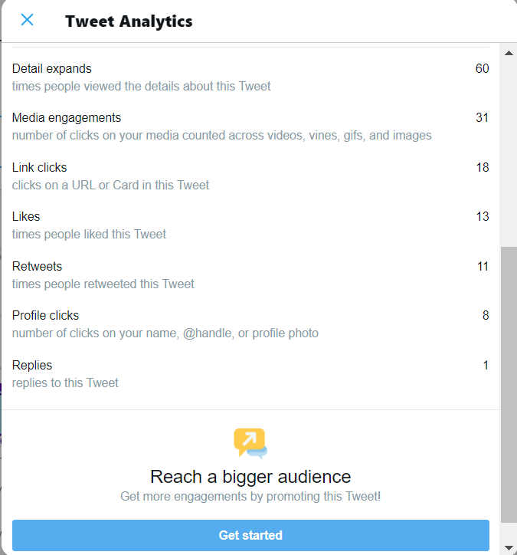
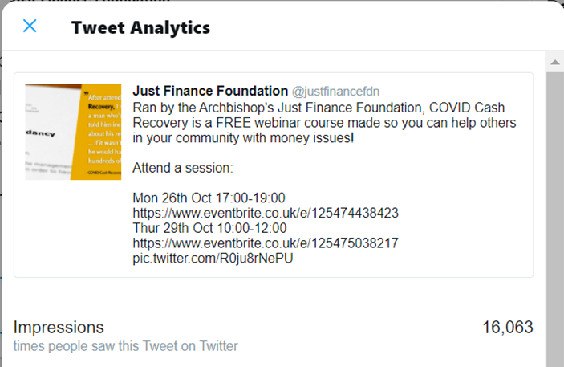
Twitter Analytics
What metrics do we need to look at to check that we were successful in posting with purpose?
Analytics
Notes:
Slide 12
There are these breakdowns of engagement
Look through the twitter analytics and talk through it all – it means 18 people have clicked onto it so it works out as promotional activity
Media engagement – means people have clicked onto the image

Slide 14
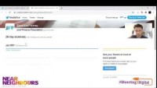
Twitter Analytics Walkthrough
Analytics
Notes:
Slide 13
Twitter analytics for beginners – youtube – watch 10 minutes and then refer people to the hub if they would like to continue watching

Slide 15

Instagram Analytics Walkthrough
Analytics
Notes:
Slide 13
Instagram analytics for beginners – youtube – accessible for free on Instagram app – have to have a (free) business account, not a personal account

Slide 16

TikTok Analytics Walkthrough
Analytics
Notes:
Slide 13
TikTok analytics for beginners – youtube -

Slide 17
Social Media Analytics
Social Media Analytics Check List
What was the goal of this post? (likes, retweets, shares, link click)
Was it successful? (what analytic metrics and tools help me understand this)
Why was this post successful/unsuccessful compared to other posts?
Analytics
Notes:
Slide 14
Social media analytics
Make sure you remember these questions throughout to ensure you are making the most of your analytics (read from slide)
You can use analytics for comparison
You might have used an eye-catching image or hashtags and you can find similarities and differences throughout

Slide 18
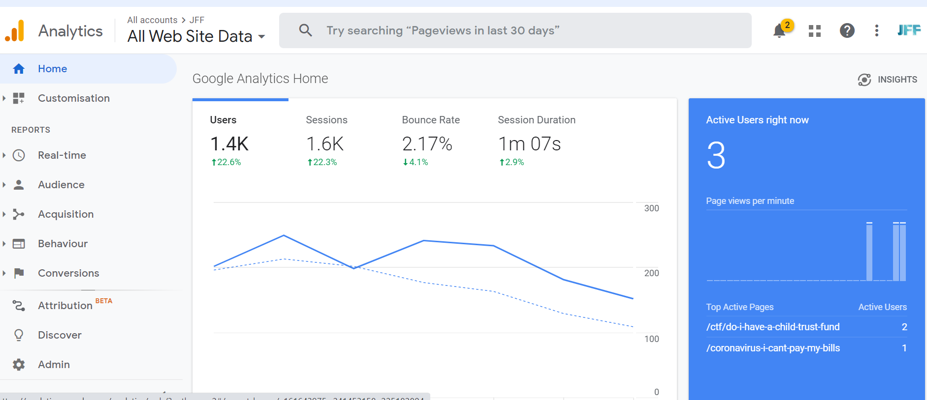
Google Analytics
What Does Google Analytics Do?
Measures website and webpage traffic
Tracks the type of people (e.g old or young) using your website
Tracks how individuals are using your website
Tracks how individuals discover your website
Why Should I Use It?
Help edit your website to get more visitors
Help you get more visitors from your target group
Understand what content your website viewers use
Analytics
Notes:
Slide 15
Google analytics
This is to do with your webpage traffic
They track the demographics of the people that use your website
Track how people are accessing your website e.g. desktop, phone, tablet
See how people find your website e.g. through a search engine, or social media
This is useful to help you edit your website to get more users
If people are sitting on your homepage it might be because all your information is there

Slide 19
Google Analytics Shortcuts
Key Questions About
Your Website
How Google Analytics
Can It For You!
How do people find my website?
Acquisition -> Overview
How do people use my website?
Behaviour -> Overview
Behaviour -> Behaviour Flows
What type of people use my website?
Audience -> Overview
How many people are visiting my website?
Audience -> Overview
What is popular on my website?
Audience -> User Flows
Behaviour -> Overview
Behaviour -> Behaviour Flows
Analytics
Notes:
Slide 16
Google analytics shortcuts
Some key questions about websites –
It looks daunting but google has these links to click on

Slide 20
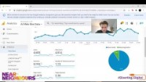
Google Analytics Walkthrough
Analytics
Notes:
Slide 17
https://analytics.google.com/analytics/web/provision/#/provision
Google analytics introduction video – forward it halfway through and inform participants that the video is available to watch on the hub

Slide 21

Search Engine Optimisation (SEO)
What Is SEO?
SEO stands for Search Engine Optimization, which is the practice of increasing the quantity and quality of traffic to your website through search engine results (like Google)
Why Is SEO Something I Should Do?
Because it can help you gain new audiences, visitors, and customers all for FREE!
Analytics
Notes:
Slide 18
Ask if anyone has heard of SEO and what it might be useful for

Slide 22
Search Engine Optimisation (SEO)
Our Top SEO Tips!
Use relevant keywords and their synonyms on your website to appear higher on google
Include your location often on your website
Customize your URLs (don’t let them be automatically generated) blog-1-1-2021 -> how-to-stay-healthy
Link to your webpages from other parts of your website.
Name your photo file image to what it shows image6528 -> Near-Neighbours-event-in-london
Keywords can really help you find new audiences.
Here are a list of places that you can use keywords on your website to boost your SEO:
Site title, URLs, SEO title and page title, item descriptions, Headings (eg, heading 1, heading 2, heading 3), Body text, Captions and titles for Image, File names for files and images
What are Keywords?
E.G if you were involved in something to do with children your keywords could be:
kids, children, child, toddlers, teenagers, babies, primary school children…
Analytics
Notes:
Slide 19
On the left hand side of the flowchart there are a few tips on how you can appear higher on google – this can be on your webpage or on captions on the webpage
Use synonyms so you have a wide base also – there are examples in the keywords box
If you keep referencing London and parenting in London, then your website will keep coming up
Your keywords can go anywhere but make sure you are using a good range of consistent keywords also

Slide 23
Search Engine Optimisation (SEO)
ACTIVITY:
Imagine we’re setting up a single parent support group/network in Newcastle. network in Newcastle.
What keywords or phrases would be useful to include in our webpage title, URL, webpage text and picture file names, to help our SEO?
Mum support group
Support for parents in Newcastle
Child support Newcastle
Single dad
Single dad Newcastle
Dad support
Parent help Newcastle
Single mum Newcastle
Single mother Newcastle
Dad group
Single parent
Single dad Newcastle
Mum network
Kid support Newcastle
Single father
Mother network
Help for single mums
Parental support
Bonus Tip: If you’re in a crowded or competitive field, you could deliberately misspell keywords in your SEO description to help you appear higher in searches! E.g mum’s gruop
Analytics
Notes:
Slide 20
Activity – let people answer and then show the examples
Cover as many bases as possible
----have a break---

Slide 24

Creating Content
Notes:
Slide 21
Creating Content
If you are more creative, this section might have some good resources for you.

Slide 25

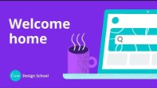
Setting Up Canva
ADDITIONAL LINKS:
Starting to design
Editing
Sharing
Creating Content
Notes:
Slide 23
Setting up canvas video

Slide 26
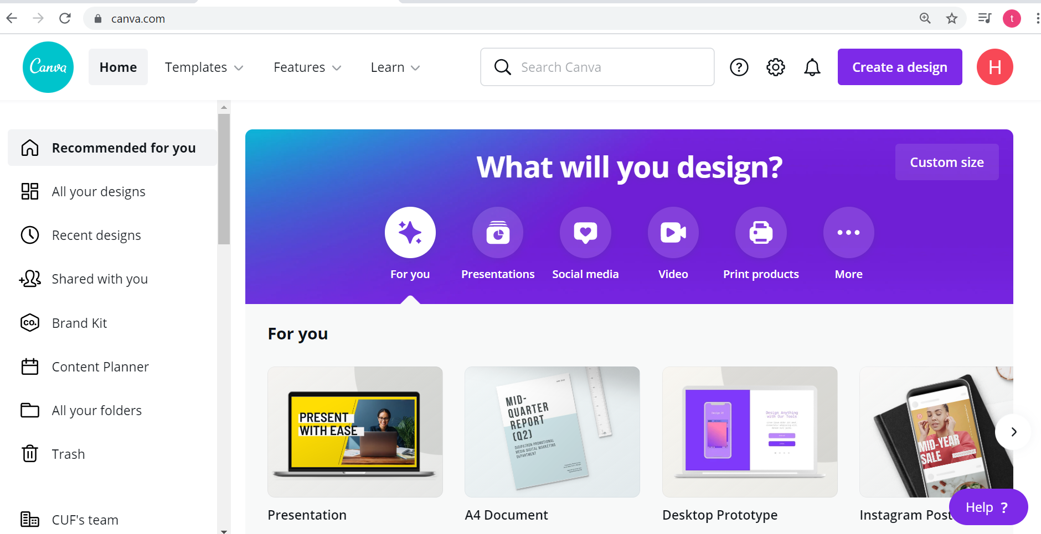
Canva Walkthrough
Creating Content
Notes:
Slide 24
Canva walkthrough of setting up a new page, selecting a template/existing design and how to upload a logo/picture.

Slide 27
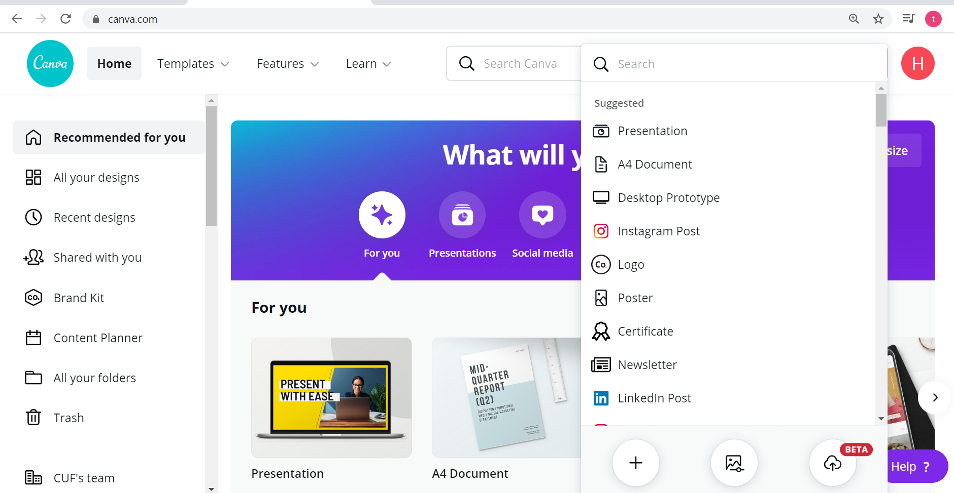
Canva Walkthrough
Creating Content
Notes:
Slide 24
Canva walkthrough of setting up a new page, selecting a template/existing design and how to upload a logo/picture.

Slide 28
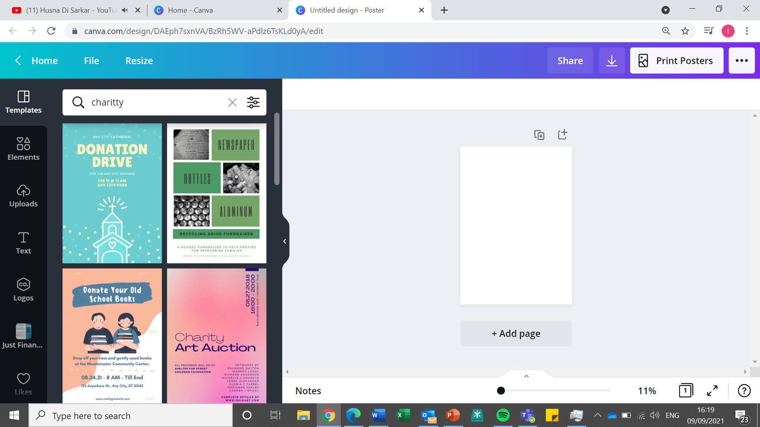
Canva Walkthrough
Creating Content
Notes:
Slide 24
Canva walkthrough of setting up a new page, selecting a template/existing design and how to upload a logo/picture.

Slide 29
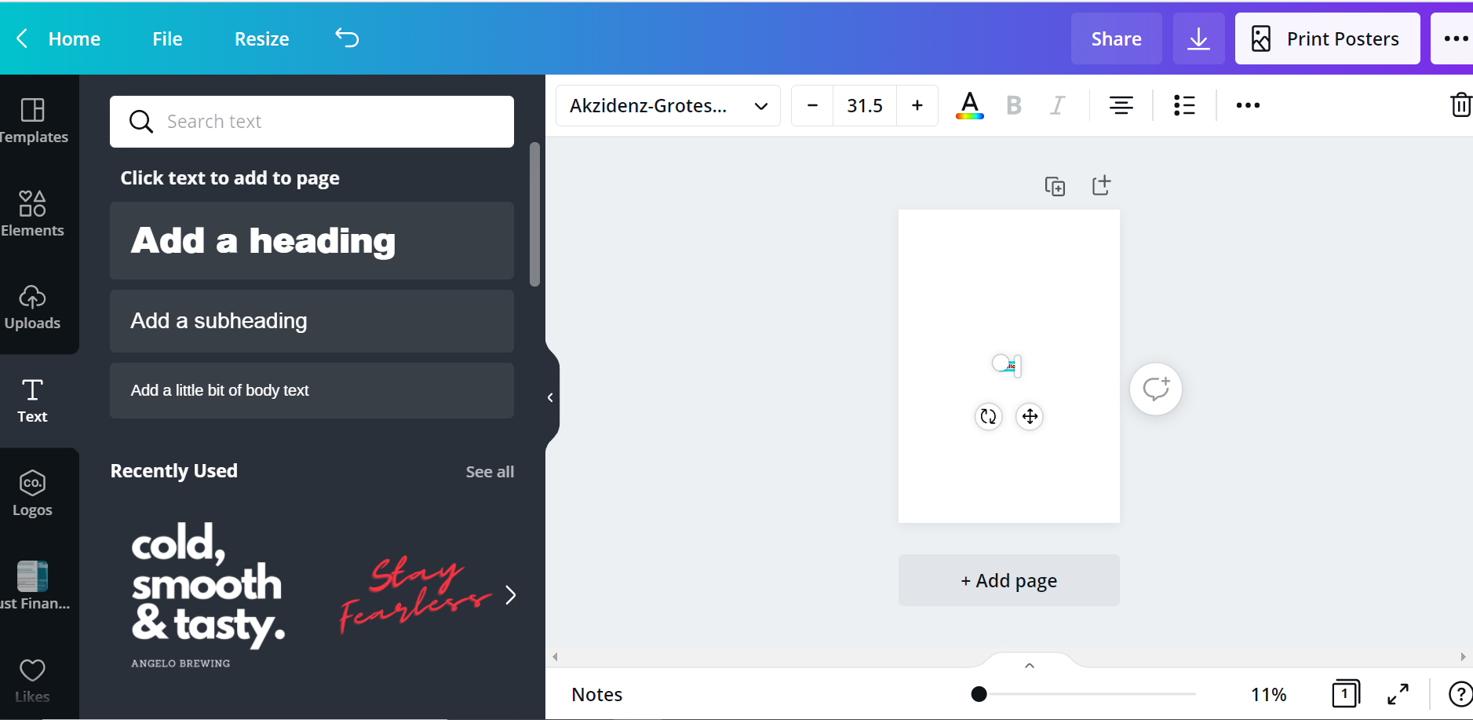
Canva Walkthrough
Creating Content
Notes:
Slide 24
Canva walkthrough of setting up a new page, selecting a template/existing design and how to upload a logo/picture.

Slide 30
What could I include in a Newsletter?
BREAKOUT ROOMS:
In the Breakout Rooms, imagine you are Young Mothers group in Newcastle – what could you include in your upcoming Newsletter?
.
Photos
Behind the scenes content
Event Reminders
Frequently Asked Questions (FAQs)
Interviews with volunteers/staff/users
Links to your Social Media
Event recaps
Success stories
Links to videos
Project updates
General news
Creating Content
Notes:
Slide 30
What could I include in a newsletter?
Pop in the chat or put the mic on
Depends on what content you have available and also make sure you brand your photos etc
GDPR note – THEY need to give you permission to sign them up to your newsletter

Slide 31

Mailchimp & Newsletters
Newsletters are a great way to regularly update supporters in a clear and informative way
Mailchimp is a free online tool with easy-to-use software and templates
You can sign up to Mailchimp for free, with a maximum capacity of 2,000 recipients
Watch MailChimp’s quick and easy to use guide on how to use their design features here
MAILCHIMP KEY WORDS:
Campaign - Newsletter
Audience - those who you want to send the newsletter too
Creating Content
Notes:
Slide 29
We recommend mailchimp, and JFF and Near Neighbours use it for our newsletters
You can also have pro accounts if you have more than 2,000 recipients to your emails and newsletters

Slide 32

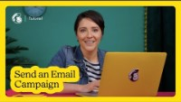
Sending a Campaign
QUICK TIP:
When sending your campaign, make sure to post on your Social Media channels to increase activity and interaction
Creating Content
Notes:
Slide 31
Play video if time permits, and suggest quick tip: When sending your campaign, make sure to post on your Social Media channels to increase activity and interaction

Slide 33





How do I use surveys?
Want to get feedback on your service? A recent event? How you could adapt and accommodate further?
Online surveys can help you to gain feedback and answers to questions in a succinct and organised manner
There are many online survey tools, however we recommend SmartSurvey
You can sign up to Smart Survey as a business or not-for-profit for free, which gives you access to the use of unlimited surveys, 100 responses per month and 15 questions per survey
SmartSurvey is easy to use and once an account is created, will give you step-by-step advice on how to create your surveys
Creating Content
Notes:
Slide 32
If you want to get feedback on your service, a recent event or know how you could adapt and accommodate further, a survey might be the best method of finding out
Online surveys can help you to gain feedback and answers to questions in a succinct and organised manner
There are many online survey tools, however we recommend Smart Survey
You can sign up to Smart Survey as a business or not-for-profit for free, which gives you access to the use of unlimited surveys, 100 responses per month and 15 questions per survey
Smart Survey is easy to use and once an account is created, will give you step-by-step advice on how to create your surveys

Slide 34
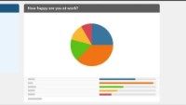
Smart Survey
Creating Content
Notes:
CSS – cascading style sheets

Slide 35
Break

Slide 36
Scheduling Social Media Posts
Notes:
Slide 21
Creating Content
If you are more creative, this section might have some good resources for you.

Slide 37
Scheduling Social Media posts
You’ve now created your content and gained understanding on Social Media analytics
A great way to utilize these analytics is by posting your content at certain times to drive engagement
Scheduling posts means you can share content and updates at specified times, across all your social media channels
Creating Content
Notes:
Slide 25
Read off slide, then
You can schedule posts on social media so you don’t need to keep posting at random times
We don’t recommend one app specifically but you can have a browse to see which one is best for you

Slide 38

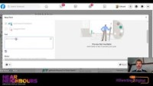
Scheduling a Facebook post
Creating Content
Notes:
Slide 26
Scheduling a Facebook post video – play it if time permits, otherwise refer participants to access the video via the hub

Slide 39
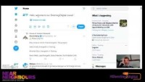
Scheduling a Tweet
Creating Content
Notes:
Slide 27
Scheduling a Tweet video – play it if time permits, otherwise refer participants to access the video via the hub

Slide 40

Scheduling an TikTok video on desktop
Creating Content
Notes:
Slide 28
As Instagram doesn’t currently allow to upload posts via a pc/desktop we can’t take you through how to schedule posts from a general account. However, if you have a business account, you can use Creator Studio on your desktop to schedule posts.
There are a large array of free apps which you can link to your Instagram which allow you to schedule posts through your phone, some of these are: Preview, Apphi and Later

Slide 41

Scheduling an Instagram Post
  If your profile on Instagram is a business account, you can use Creator Studio on your desktop to schedule posts
  If, however, you want to schedule posts via your mobile phone, unfortunately the Instagram app does not allow you to do so just yet.
  There are a large array of free apps which you can link to your Instagram which allow you to schedule posts through your phone, some of these are: Preview, Apphi and Later
Creating Content
Notes:
Slide 28
As Instagram doesn’t currently allow to upload posts via a pc/desktop we can’t take you through how to schedule posts from a general account. However, if you have a business account, you can use Creator Studio on your desktop to schedule posts.
There are a large array of free apps which you can link to your Instagram which allow you to schedule posts through your phone, some of these are: Preview, Apphi and Later

Slide 42

Scheduling Platforms - Hootsuite
  Rather than scheduling posts on each individual social media platform, you can use sites like Hootsuite to schedule posts across all of your platforms at once.
  Hootsuite allows you to schedule posts across different platforms, see what you’ve posted and what you have coming up, and even look at how well your posts are doing.
  This is especially useful if you use multiple social media platforms. It can help you keep track of your posts and the Analytics tool can help you see which types of posts your followers are engaging with the most.
  There is also a discount of up to 50% for charities that you can apply for here: HootGiving: a Nonprofit Program by Hootsuite
Creating Content

Slide 43

Using Hootsuite
Creating Content
Notes:
Slide 33
Hootsuite have a Youtube channel with a whole series of videos on how to use their platform – basics as well as advanced features

Slide 44
Useful Videos - Hootsuite
  An Overview of the Hootsuite Dashboard:
  How to Publish to Instagram with Hootsuite:
  How to Add a Social Network in Hootsuite:
  How to Post with Hootsuite Using a Computer:
  How to Publish to Instagram with Hootsuite:
Creating Content

Slide 45
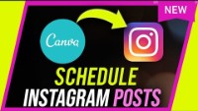
Scheduling SM posts using Canva Pro
Creating Content
Notes:
Slide 24
Canva walkthrough of setting up a new page, selecting a template/existing design and how to upload a logo/picture.

Slide 46
Branching Out
Notes:
Branching out
This covers online fundraising – even though you can fundraise online now this is something you might find useful doing

Slide 47
Online Fundraising
Why Fundraise Online?
Branching Out
Notes:
Slide 34
Online fundraising is still the dominant type of fundraising
Social media is the top way to establish a fundraising campaign and email is the final method
go through 2-3 of these

Slide 48

Online Fundraising
Online Donation Forms or platforms (see next slide)
Crowdfunding
E-appeal – using an online newsletter or email
Find large grant providers: Funds Online
5. Online Auction – use ZOOM to auction donated items!
6. Facebook/Social Media Fundraiser
Branching Out

Slide 49

Online Fundraising Platforms
CAF Donate
+ Advantages: Cheap processing fee, can create online donation forms easily
- Disadvantages: Less recognised by donors
Crowdfunder
+ Advantages: Very flexible, can fundraiser for any cause
- Disadvantages: £3 service usage fee
Total Giving
+ Advantages: Free online service
- Disadvantages: Less recognised by donors
GoFundMe
+ Advantages: Partnered with PayPal, very quick and easy to set up fundraising campaigns
- Disadvantages: Processing Fee: 2.9% + 25p per transaction
Just Giving
+ Advantages: Reputable, can also use QR codes
- Disadvantages: Expensive, monthly subscription fee of £15 + VAT or £39 + VAT.
PayPal
+ Advantages: simple to set up and reputable amongst donors, can be used in person and just online
- Disadvantages: credit/debit card processing fee
Branching Out
Notes:
Slide 35
On slide you can see some platforms to use for fundraising online. We would advise you to research into these to assess which would be best suitable for your organisation and cause.

Slide 50






Engaging with others
You can further expand your audience and reach by engaging with others
Regularly tag other relevant organisations in your posts on Social Media: e.g @nearneighbours
Make sure to link all your Social Media throughout your content i.e. newsletters, websites and flyers
Share/Retweet/Repost others content on to your profiles
Be open to regular conversation with followers and supporters through your Social Media platforms
Make use of #hastags, perhaps even creating one yourself?
Reach out to other suitable organisations/groups via Direct Messaging, suggesting an online collaboration or simply expressing interest in working together
Quick Tip:
When creating a new #hashtag to drive conversation, make sure to keep it relevant, not too long, and capitalise each different word for clarity
Branching Out
Notes:
Slide 37
At the start when I asked you how you would want to use social media more innovatively you might have said to help you expand your audience, so this slide will be useful for you.
In order to engage with relevant people and organisations, make sure you tag other relevant organisations - make sure you don’t tag someone that has nothing to do with your organisation and check their account handle (@)
Go through each point on the slide

Slide 51
Advanced Zoom
Notes:
Slide 38
Advanced Zoom

Slide 52
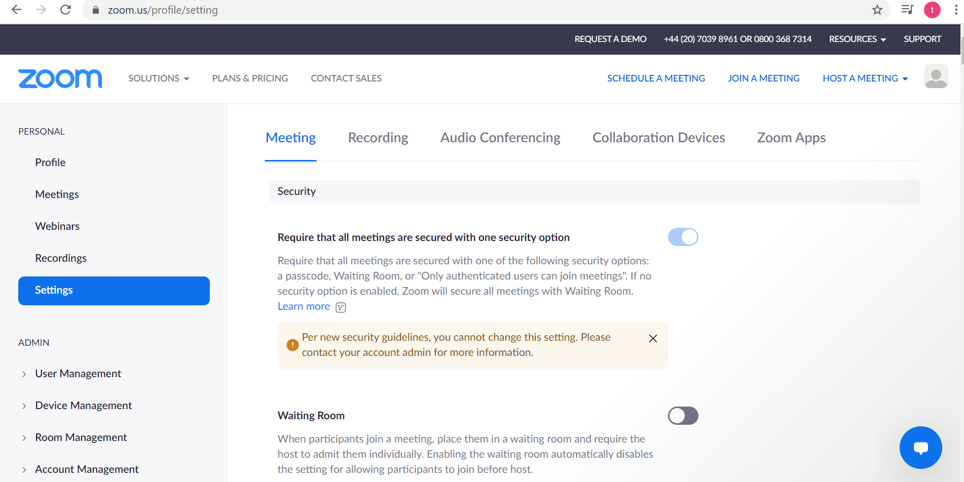
Breakout Rooms
Notes:
Slide 38
Advanced Zoom

Slide 53
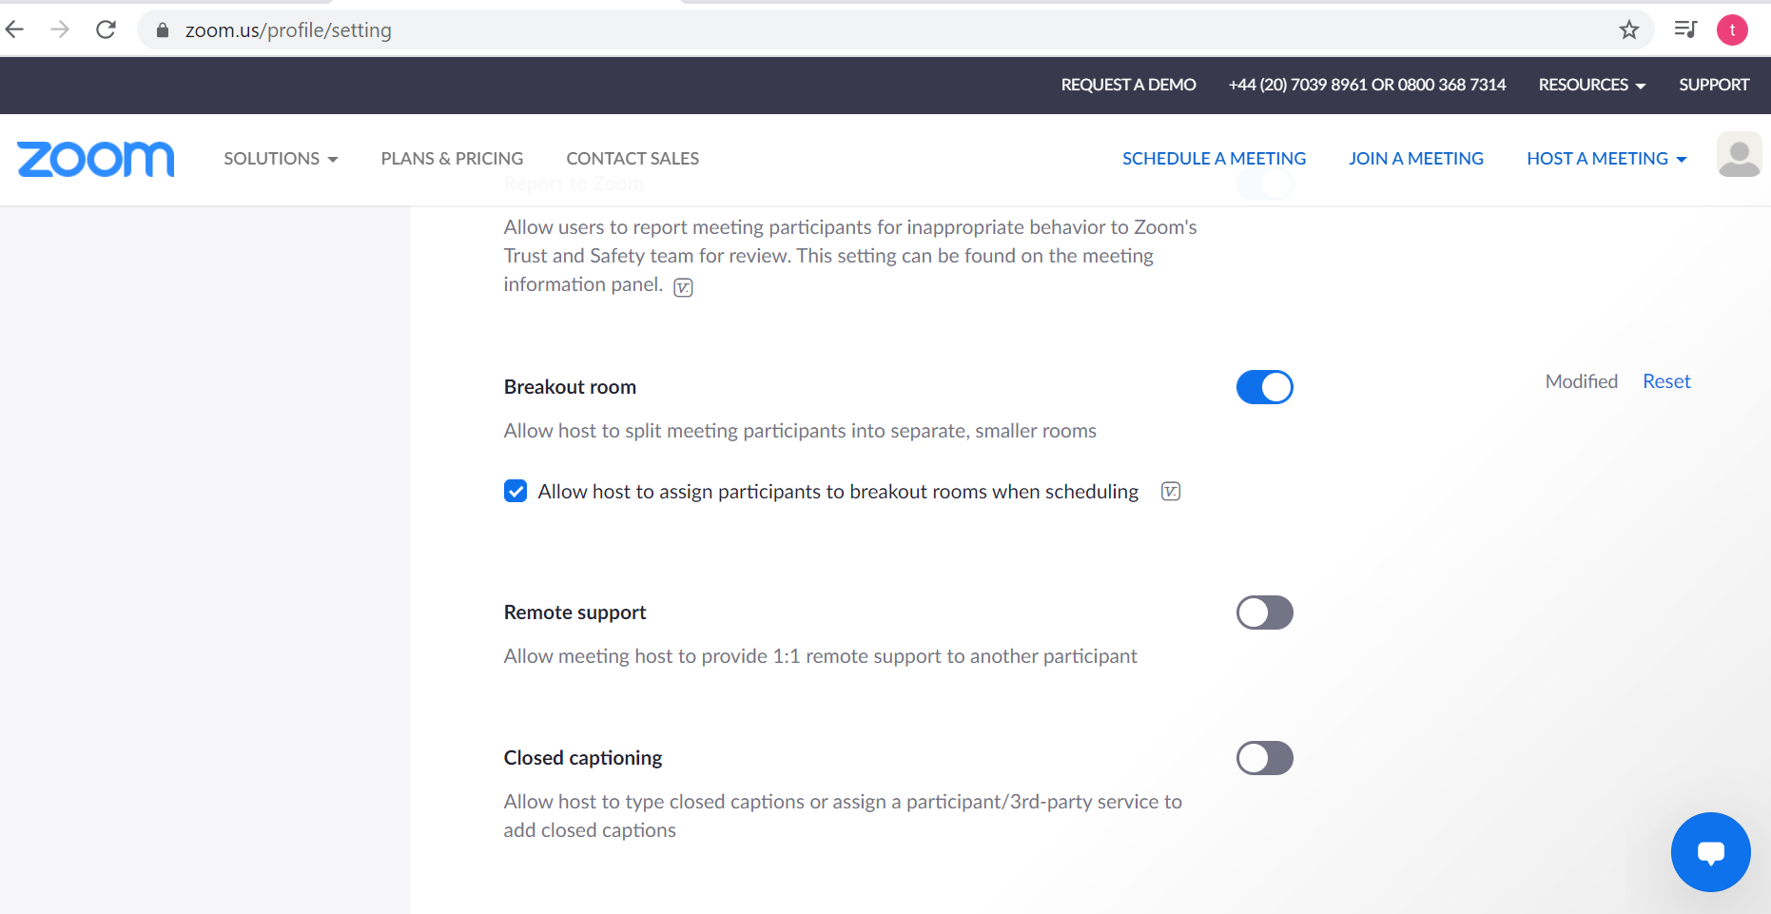
Breakout Rooms
Notes:
Slide 38
Advanced Zoom

Slide 54
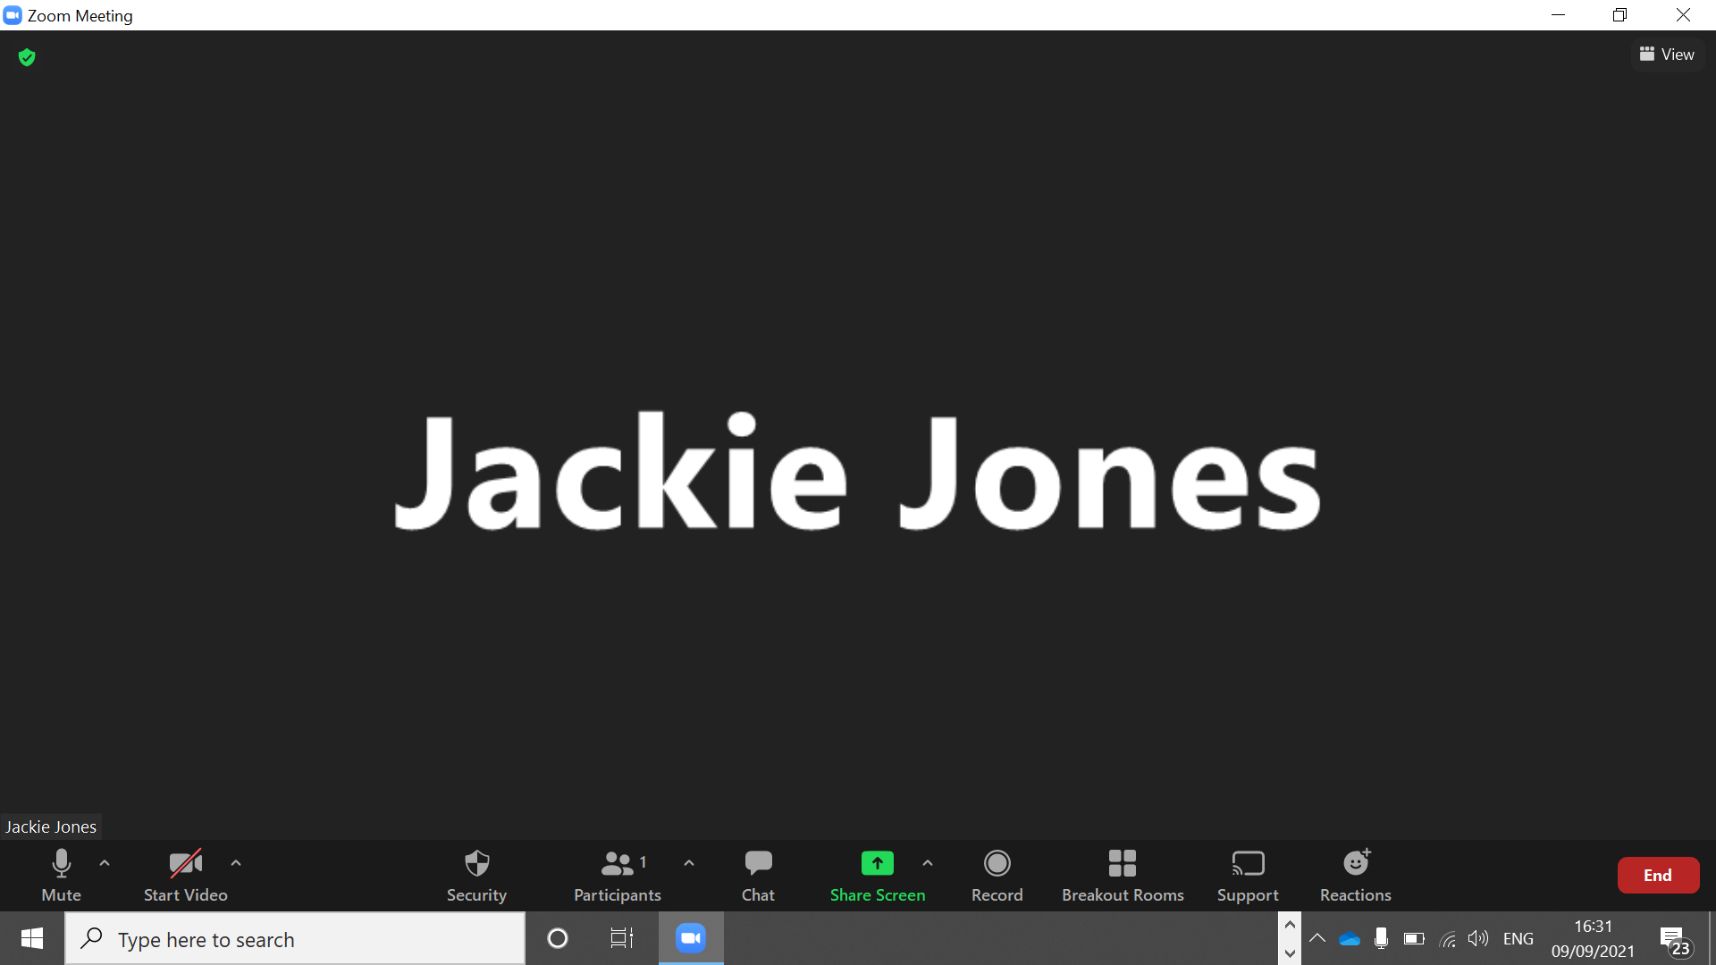
Breakout Rooms
Notes:
Slide 38
Advanced Zoom

Slide 55
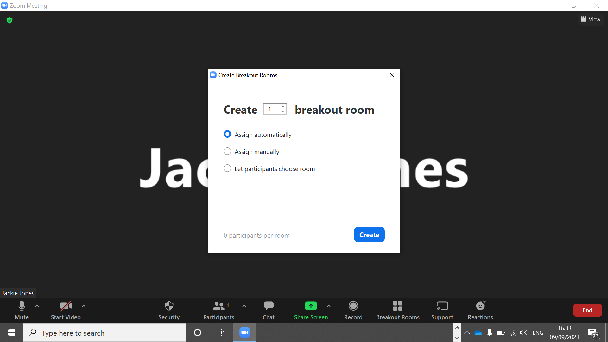
Breakout Rooms
Notes:
Slide 38
Advanced Zoom

Slide 56

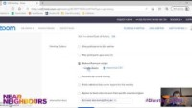
Using Breakout Rooms
Advanced Zoom
Notes:
Slide 39
Breakout rooms – using these features on the PowerPoint – sometimes that became redundant if there weren’t enough people using the course
If coordinators were sitting in the calls it meant you could assign them to lead breakout rooms
Here is a video on how to set up breakout rooms on Zoom

Slide 57
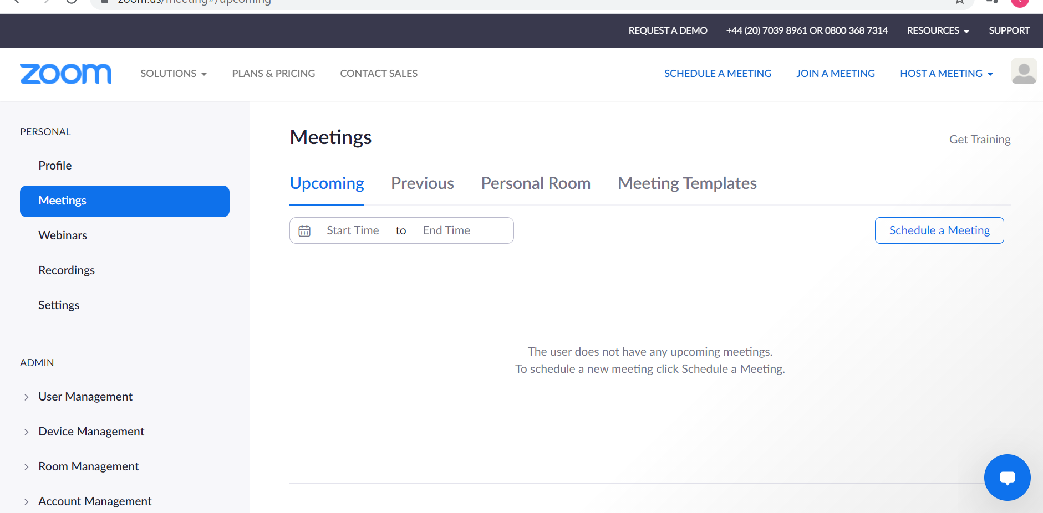
Using polls
Notes:
Slide 38
Advanced Zoom

Slide 58
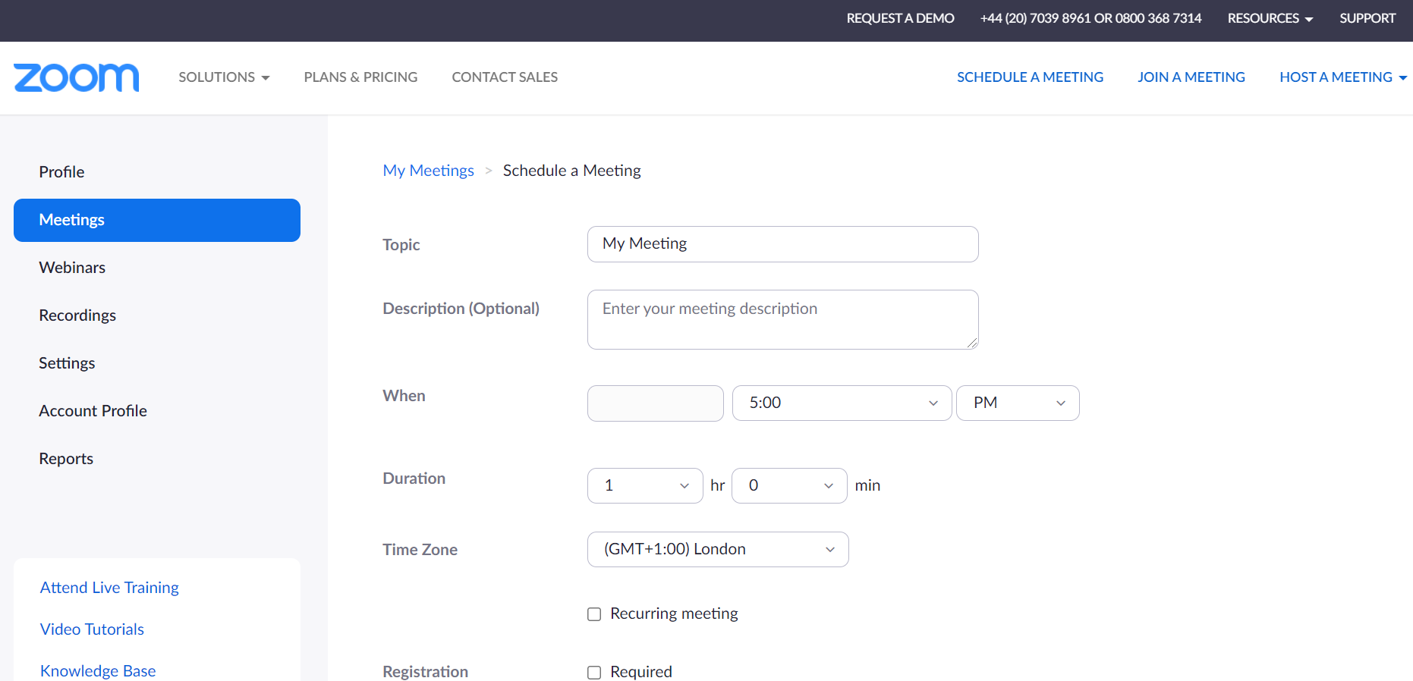
Using polls
Notes:
Slide 38
Advanced Zoom

Slide 59
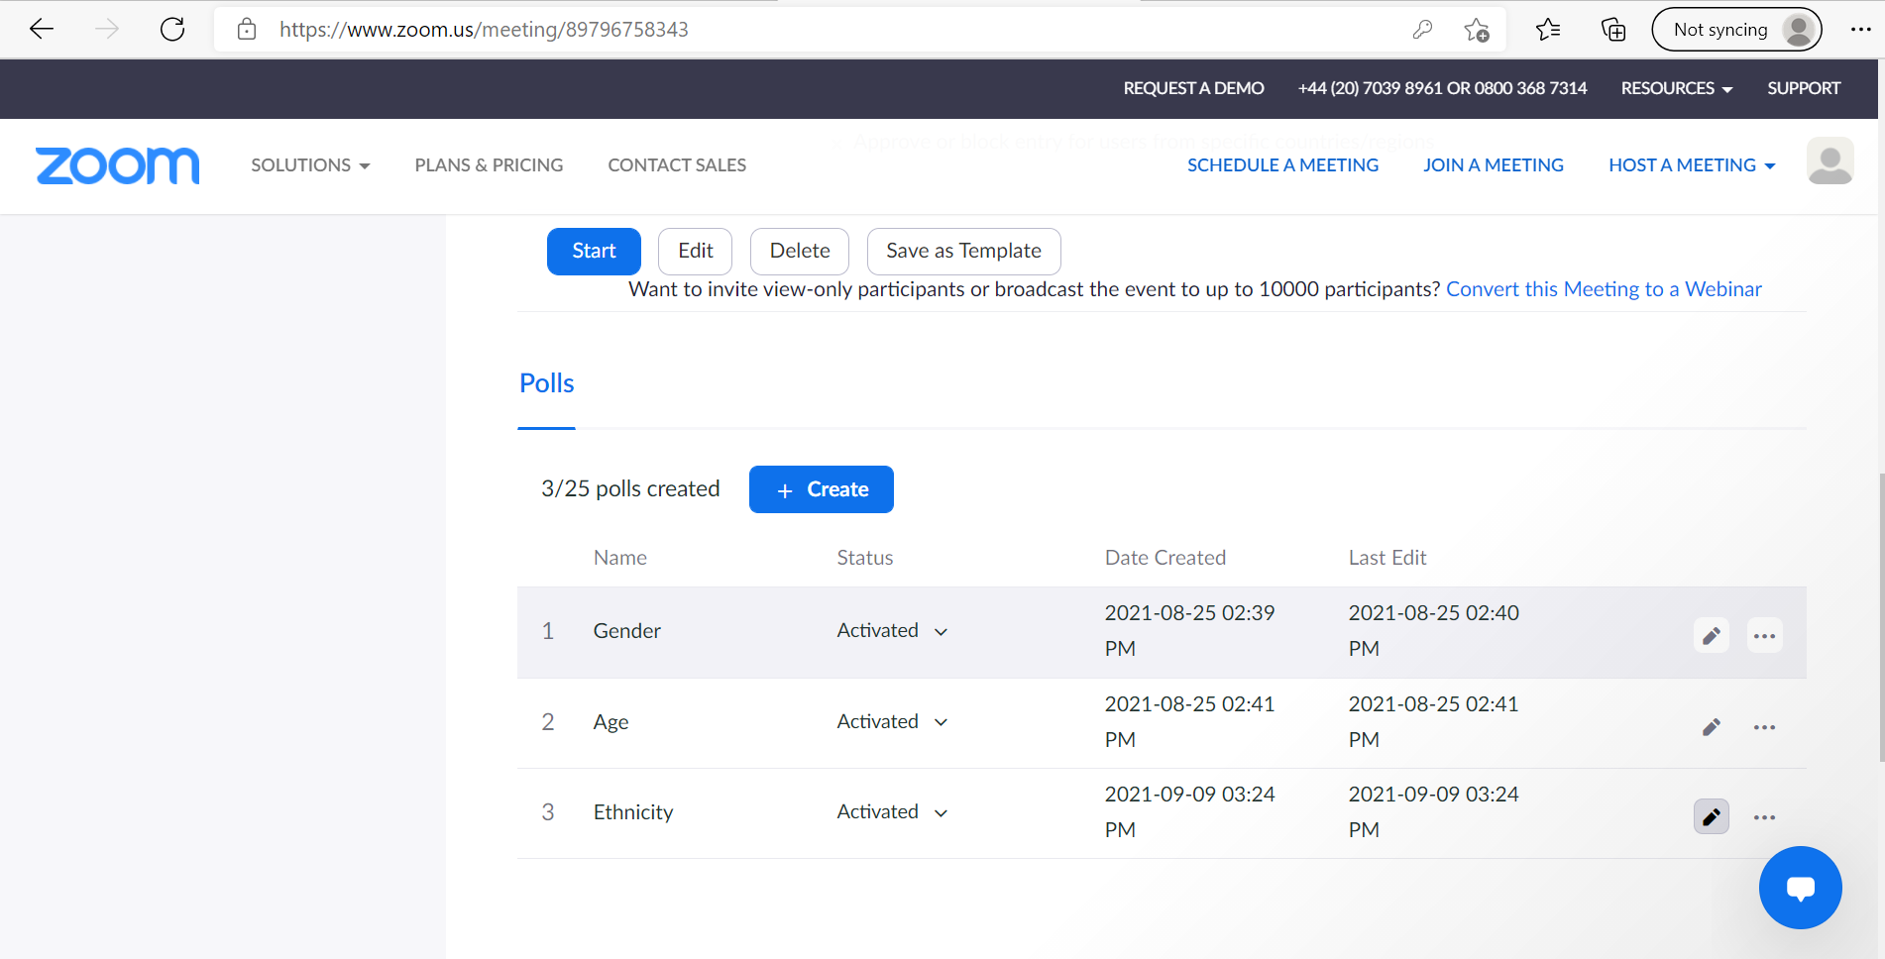
Using polls
Notes:
Slide 38
Advanced Zoom

Slide 60
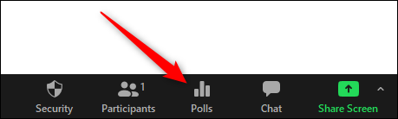
Using polls
Notes:
Slide 38
Advanced Zoom

Slide 61
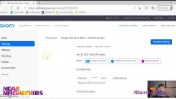
Using Polls
Advanced Zoom
Notes:
Slide 40
Play video

Slide 62
Questions
Questions?
Notes:
Slide 41
Questions
If there are questions we cannot answer, give email address and tell them we will do research and get back to queries
https://www.smartsurvey.co.uk/s/Diverting2Digital/

