Slide 1
An Introduction to hybrid events
What is a hybrid event?
A hybrid event is one which combines a "live" in-person event with a "virtual" online component.
What do hybrid events look like:

Slide 2
Example hybrid events
A charity has approximately 20% office-based staff, 50% working in night shelters and the other 30% working in the community. Historically staff attendance at the all-staff quarterly meetings was very low. Non-office-based staff sighting long journey times and busy diaries as reasons for their non-attendance. Since the global pandemic, they embraced hybrid meetings as the norm and attendance at the all-staff meetings has greatly increased.
A faith group are having an event in honor of a historic event. 2 historians and 4 faith leaders are there in person they also have 2 international speaker are joining the discussions virtually. In the audience they have 60 people gathered in-person and a further 70 people have joined virtually. In the question-and-answer segment, questions will be taken from both virtual attendees and from the live audience.
A local knit and natter group found that since the global pandemic a number of its members have been anxious around meeting in person, to try reconnect with those who had not attended in a while the group held a session sitting around one large meeting table in a community hall. Those attending virtually could still be part of the conversation and see everyone although the camera angles were not always the most flattering.

Slide 3
An Introduction to hybrid events
Why might you want to hold a hybrid event?
Increase participation
To be inclusive
Convenient for participants and/or hosts
Contingency planning i.e. bad weather
It can be more cost effective
To increase your reach
Can help reduce the number of people meeting in person:
to fit venue capacity or to meet government restrictions
What is your reason?

Slide 4
An Introduction to hybrid events
Screen | Camera
Microphone | Loudspeaker
Notes:
Throughout this session we are going to look at how we can successfully incorporate the 4 elements required in all hybrid events:
Screen – so we can see those attending the meeting virtually and to display presentations
Camera - So those attending virtually can see those attending in person
Microphone - So those attending virtually can hear us.
Loudspeaker - So those attending in person can hear us.

Slide 5
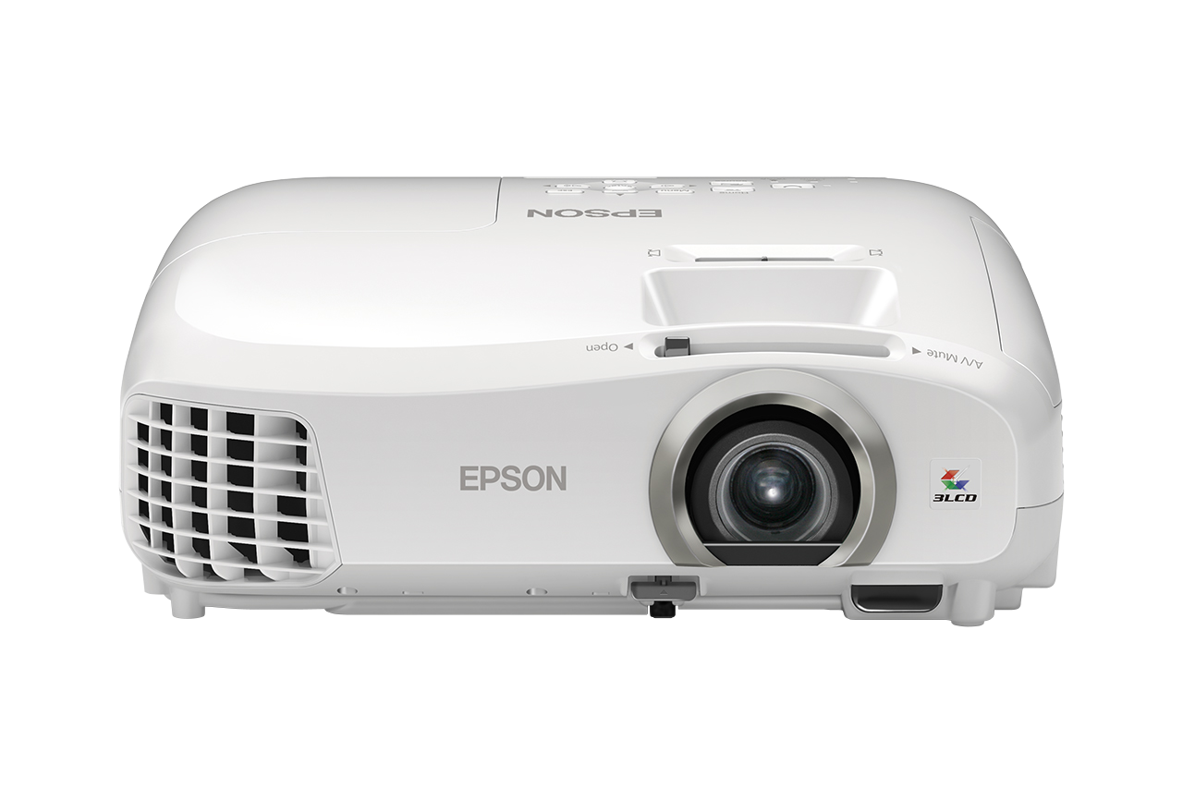
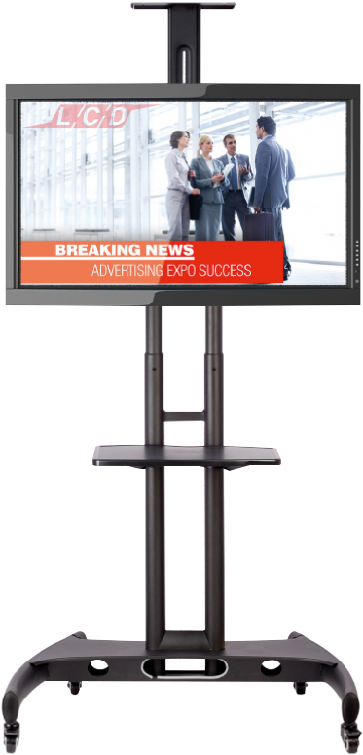
An Introduction to hybrid events - Screens
Projector
Electronic/Smart whiteboard
Laptop
Monitor
TV on a stand
Notes:
First we have a look at the screen element – a screen in this context is a device use display visual content. As you can see there are plenty of different options, all at different price points and it’s important to know what is appropriate to use when. We are not proposing you need to go out and buy different bits of ‘kit’ for each type of event, but it is good to take into consideration the options available in your event planning.

Slide 6
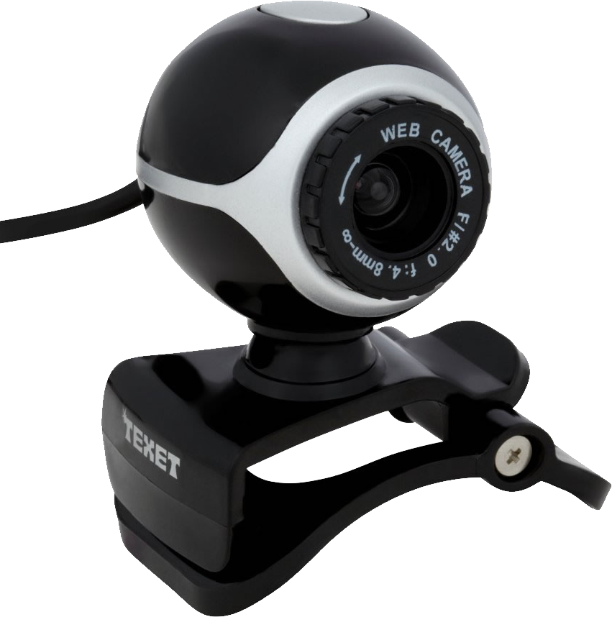
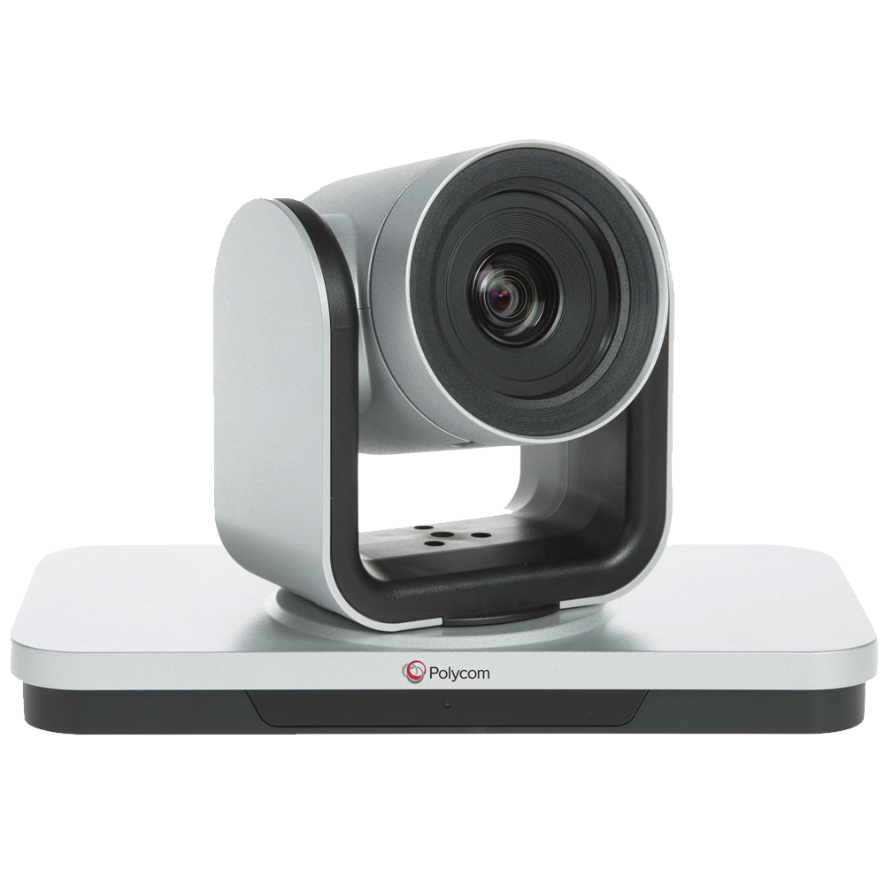
An Introduction to hybrid events - Cameras
Laptop
USB webcam
Conference camera
Notes:
Now we have our cameras – we have a webcam (wired) and conference cam which is not necessarily wired. Webcams can be controlled by a laptop to point to different people as required. Conference cameras can be set to move to whoever is speaking automatically and some also act as a microphone.

Slide 7
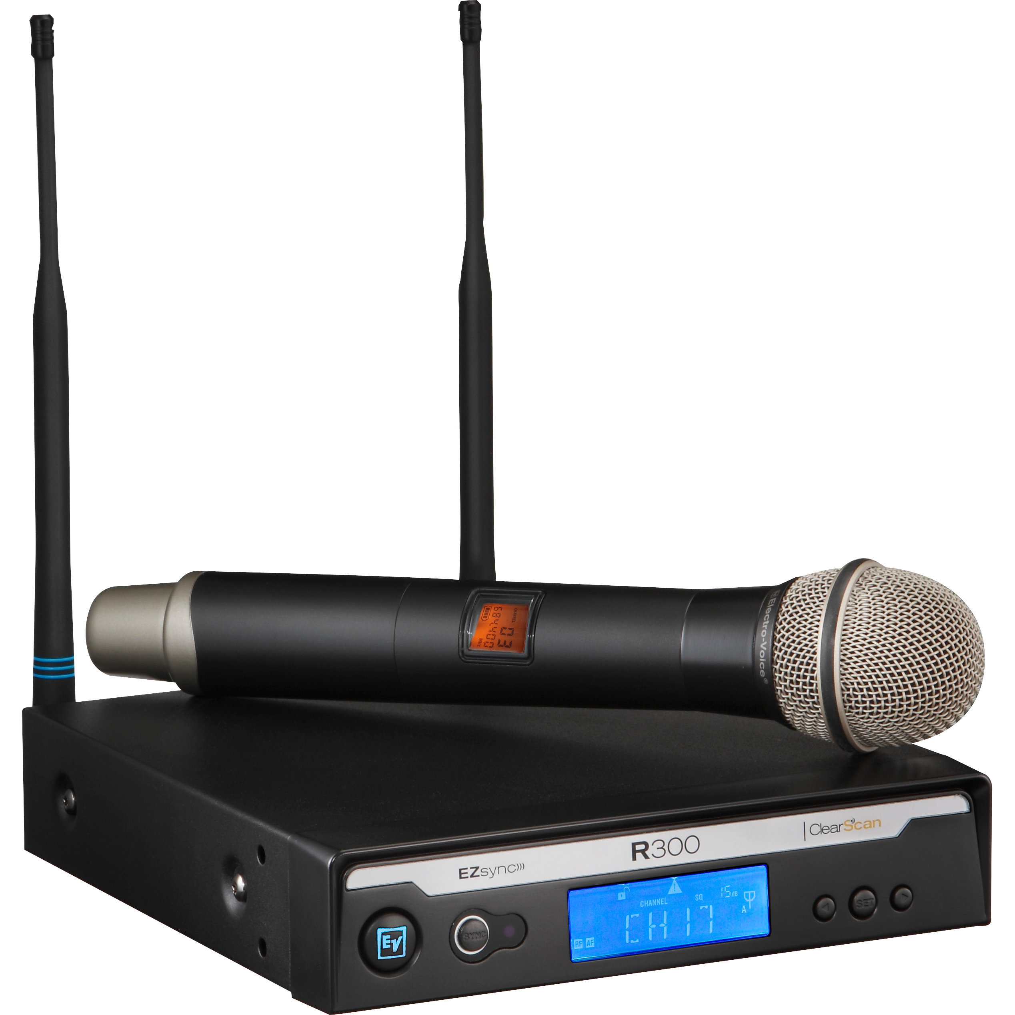
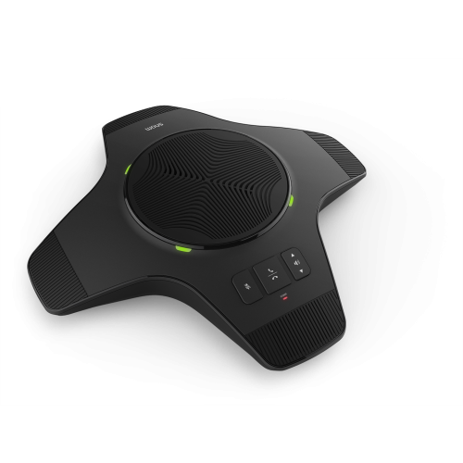
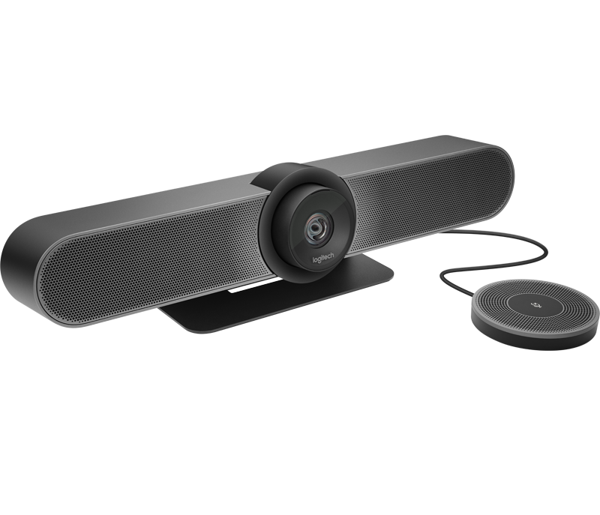
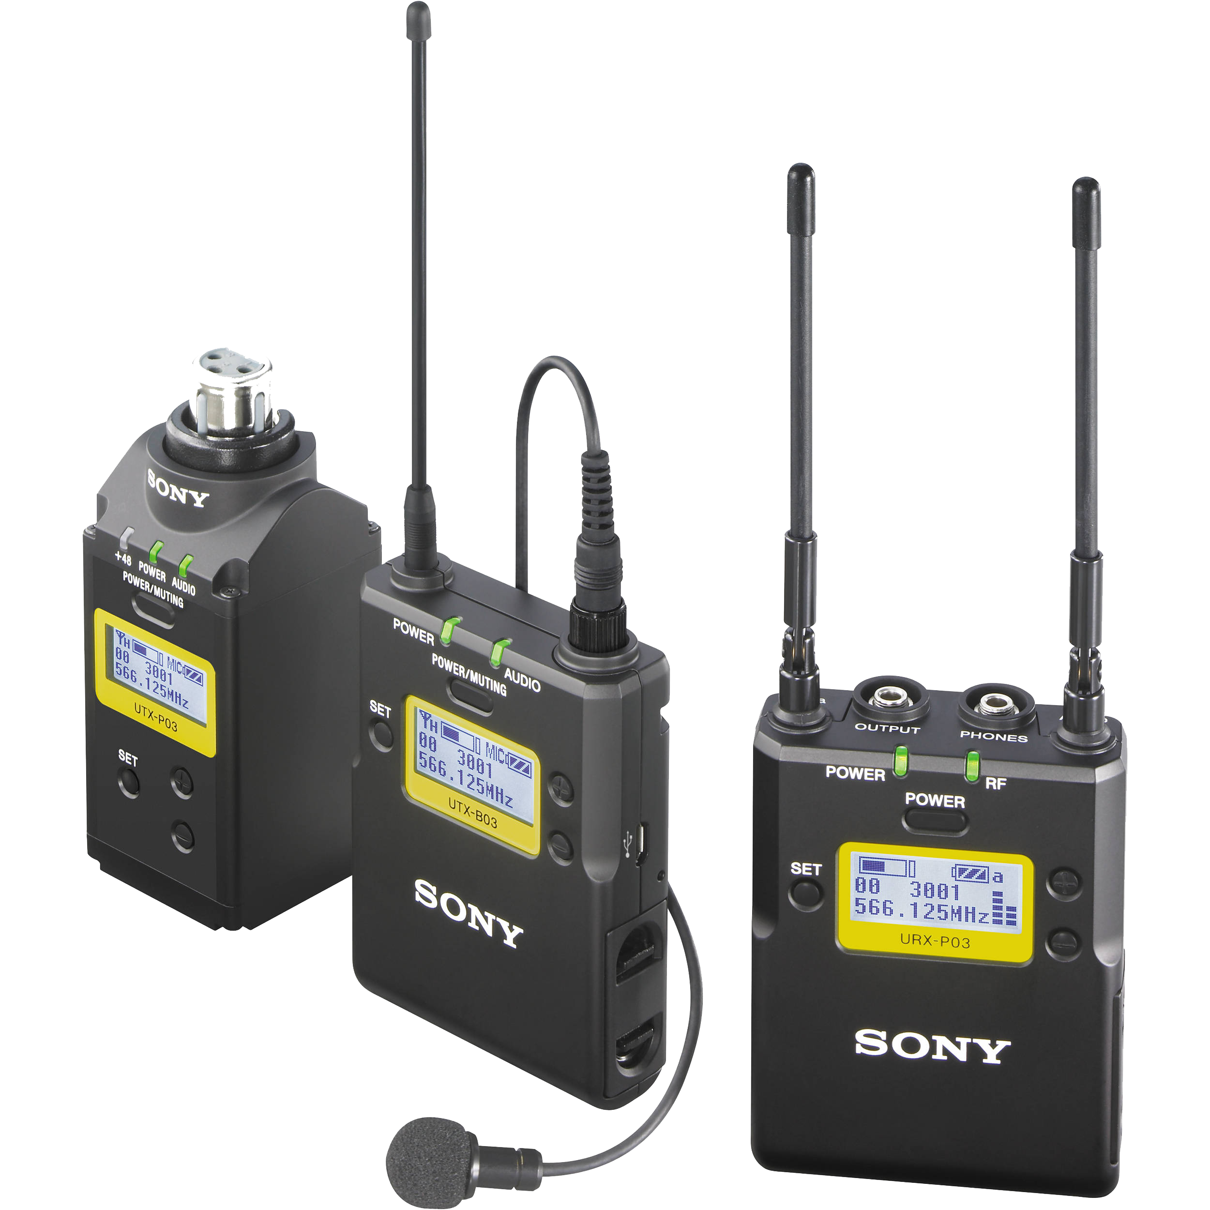
Example equipment - Microphone
An Introduction to hybrid events - Microphones
Laptop
Microphone (with inbuilt transmitter) and receiver.
Microphone, transmitter and receiver.
Conference microphone and loudspeaker
Conference microphone and loudspeaker

Slide 8
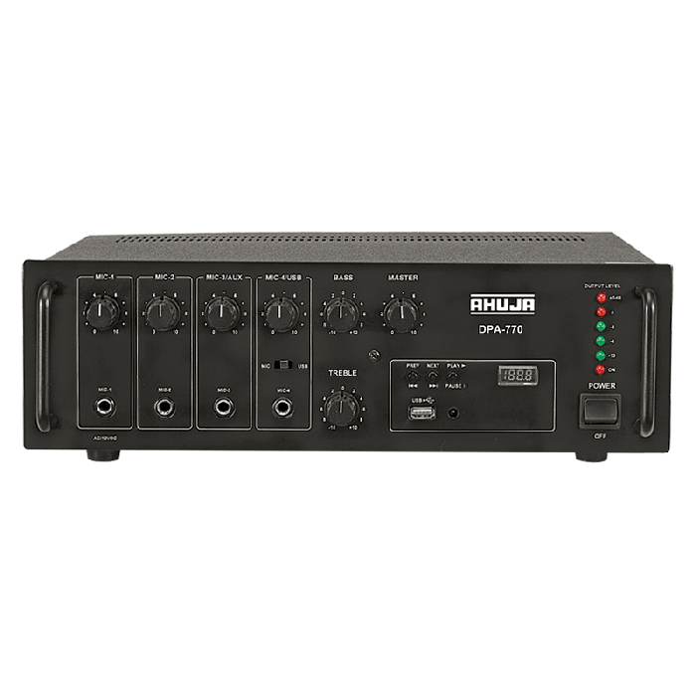
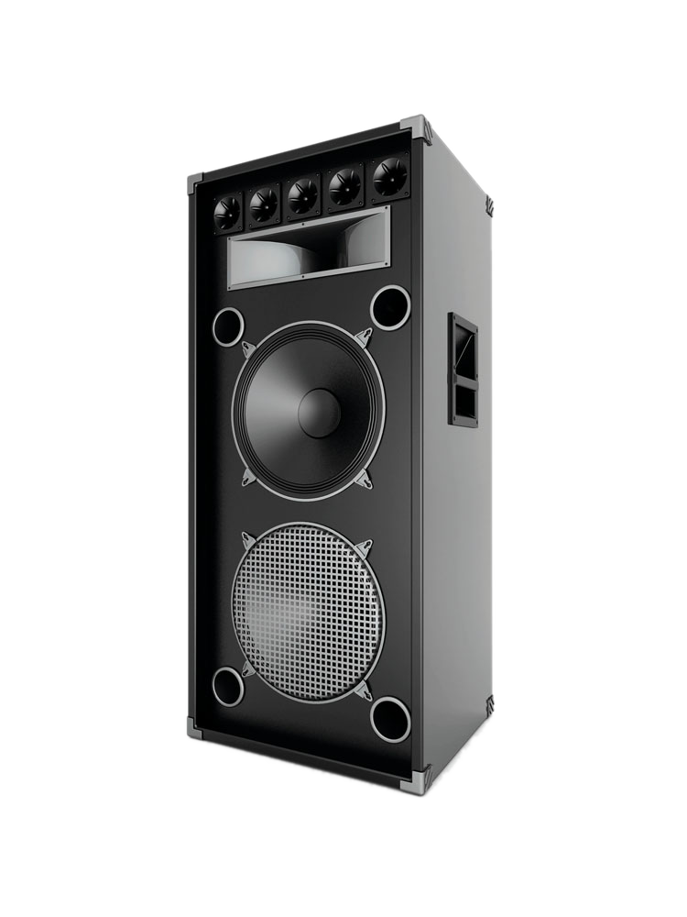
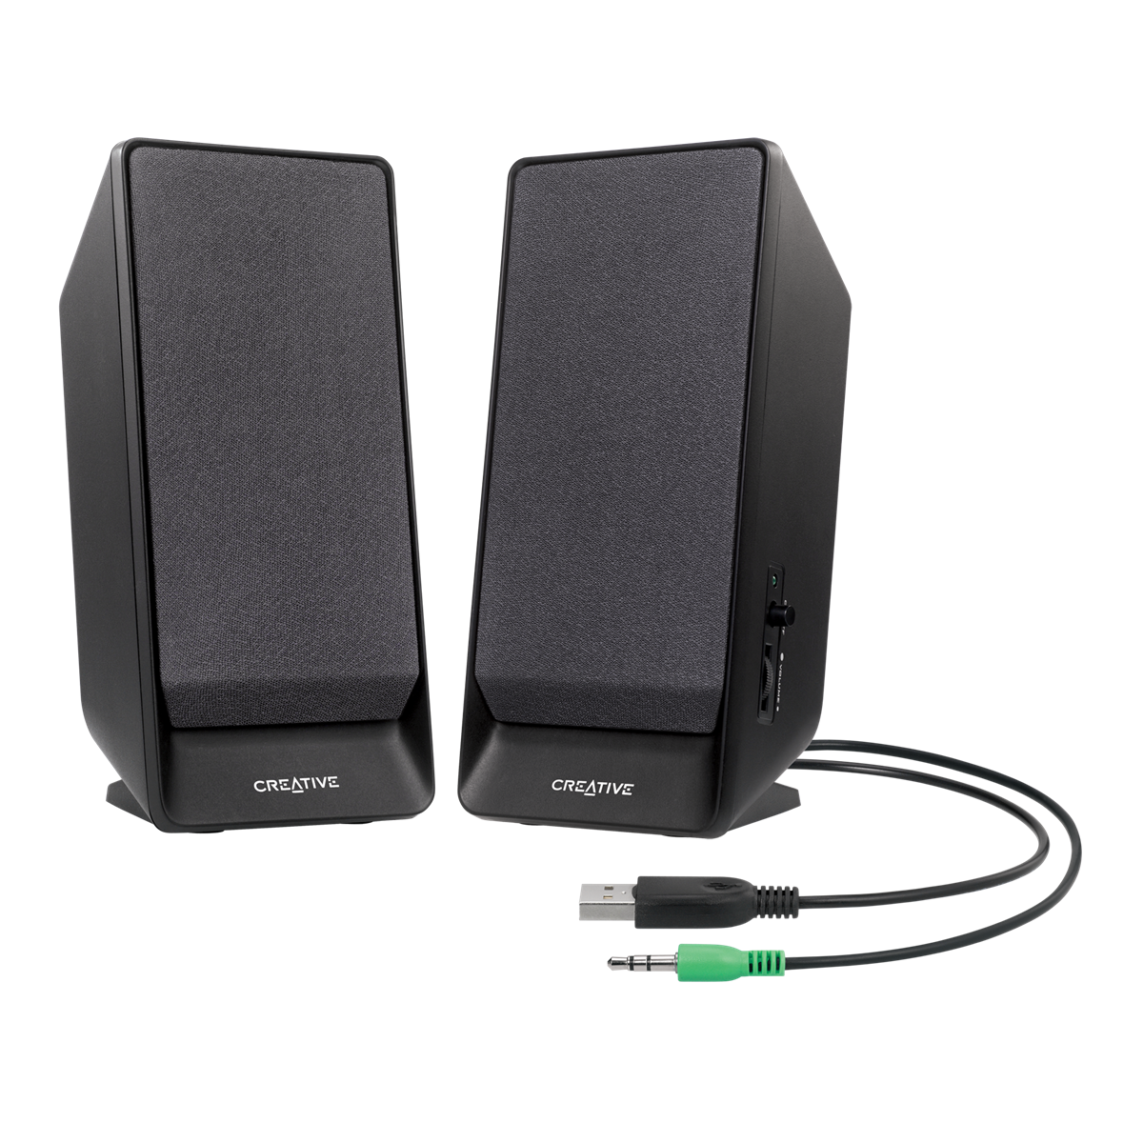
An Introduction to hybrid events - Loudspeakers
Amplifier
Conference microphone and loudspeaker
TV
Conference microphone and loudspeaker
USB Speakers
Loudspeaker

Slide 9
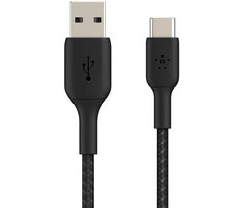
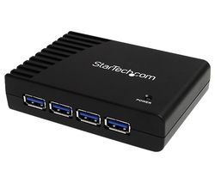
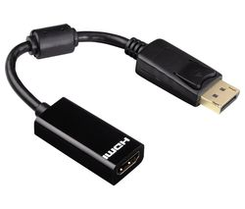
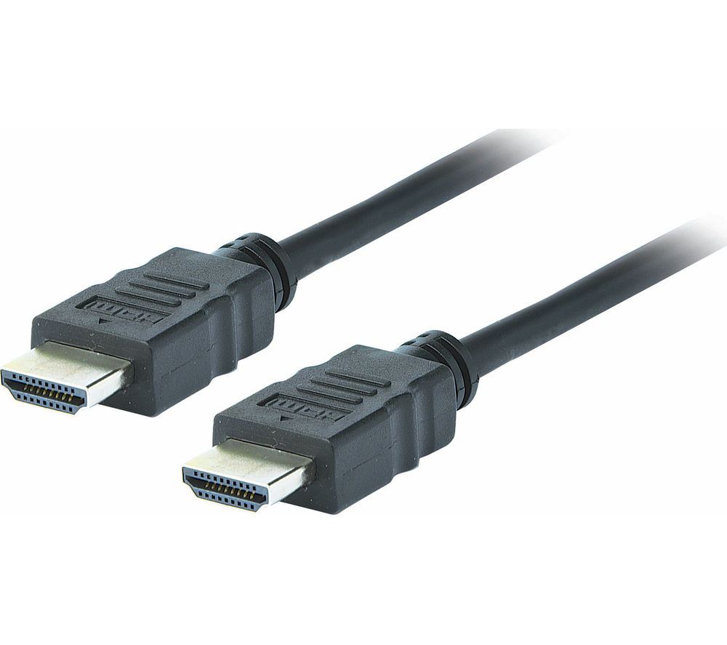
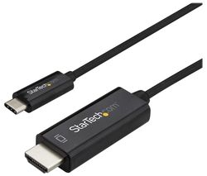
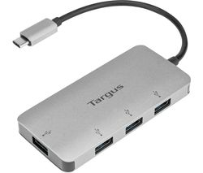
An Introduction to hybrid events
HDMI to USB- A adaptor
USB-A to USB-A hub
USB - A
USB - B
USB-C to USB-A hub
HDMI to HDMI Cable
HDMI to USB-C adaptor
Notes:
Your laptop is going to be the conduit with which the session operates. You therefore need to know how to connect things up. Some slimmer laptops have fewer ports, you will therefore need to look at whether you need to invest in a USB hub. It is also worth noting there is 2 sizes of USB port, type A (which is the most common type) and type C which is what slimmer laptops tend to have. USB C ports usually connect to other devices via an adaptor or hub. If you are not sure what you it’s best to check photos online or go to somewhere like PC world where the shop staff will advise.

Slide 10
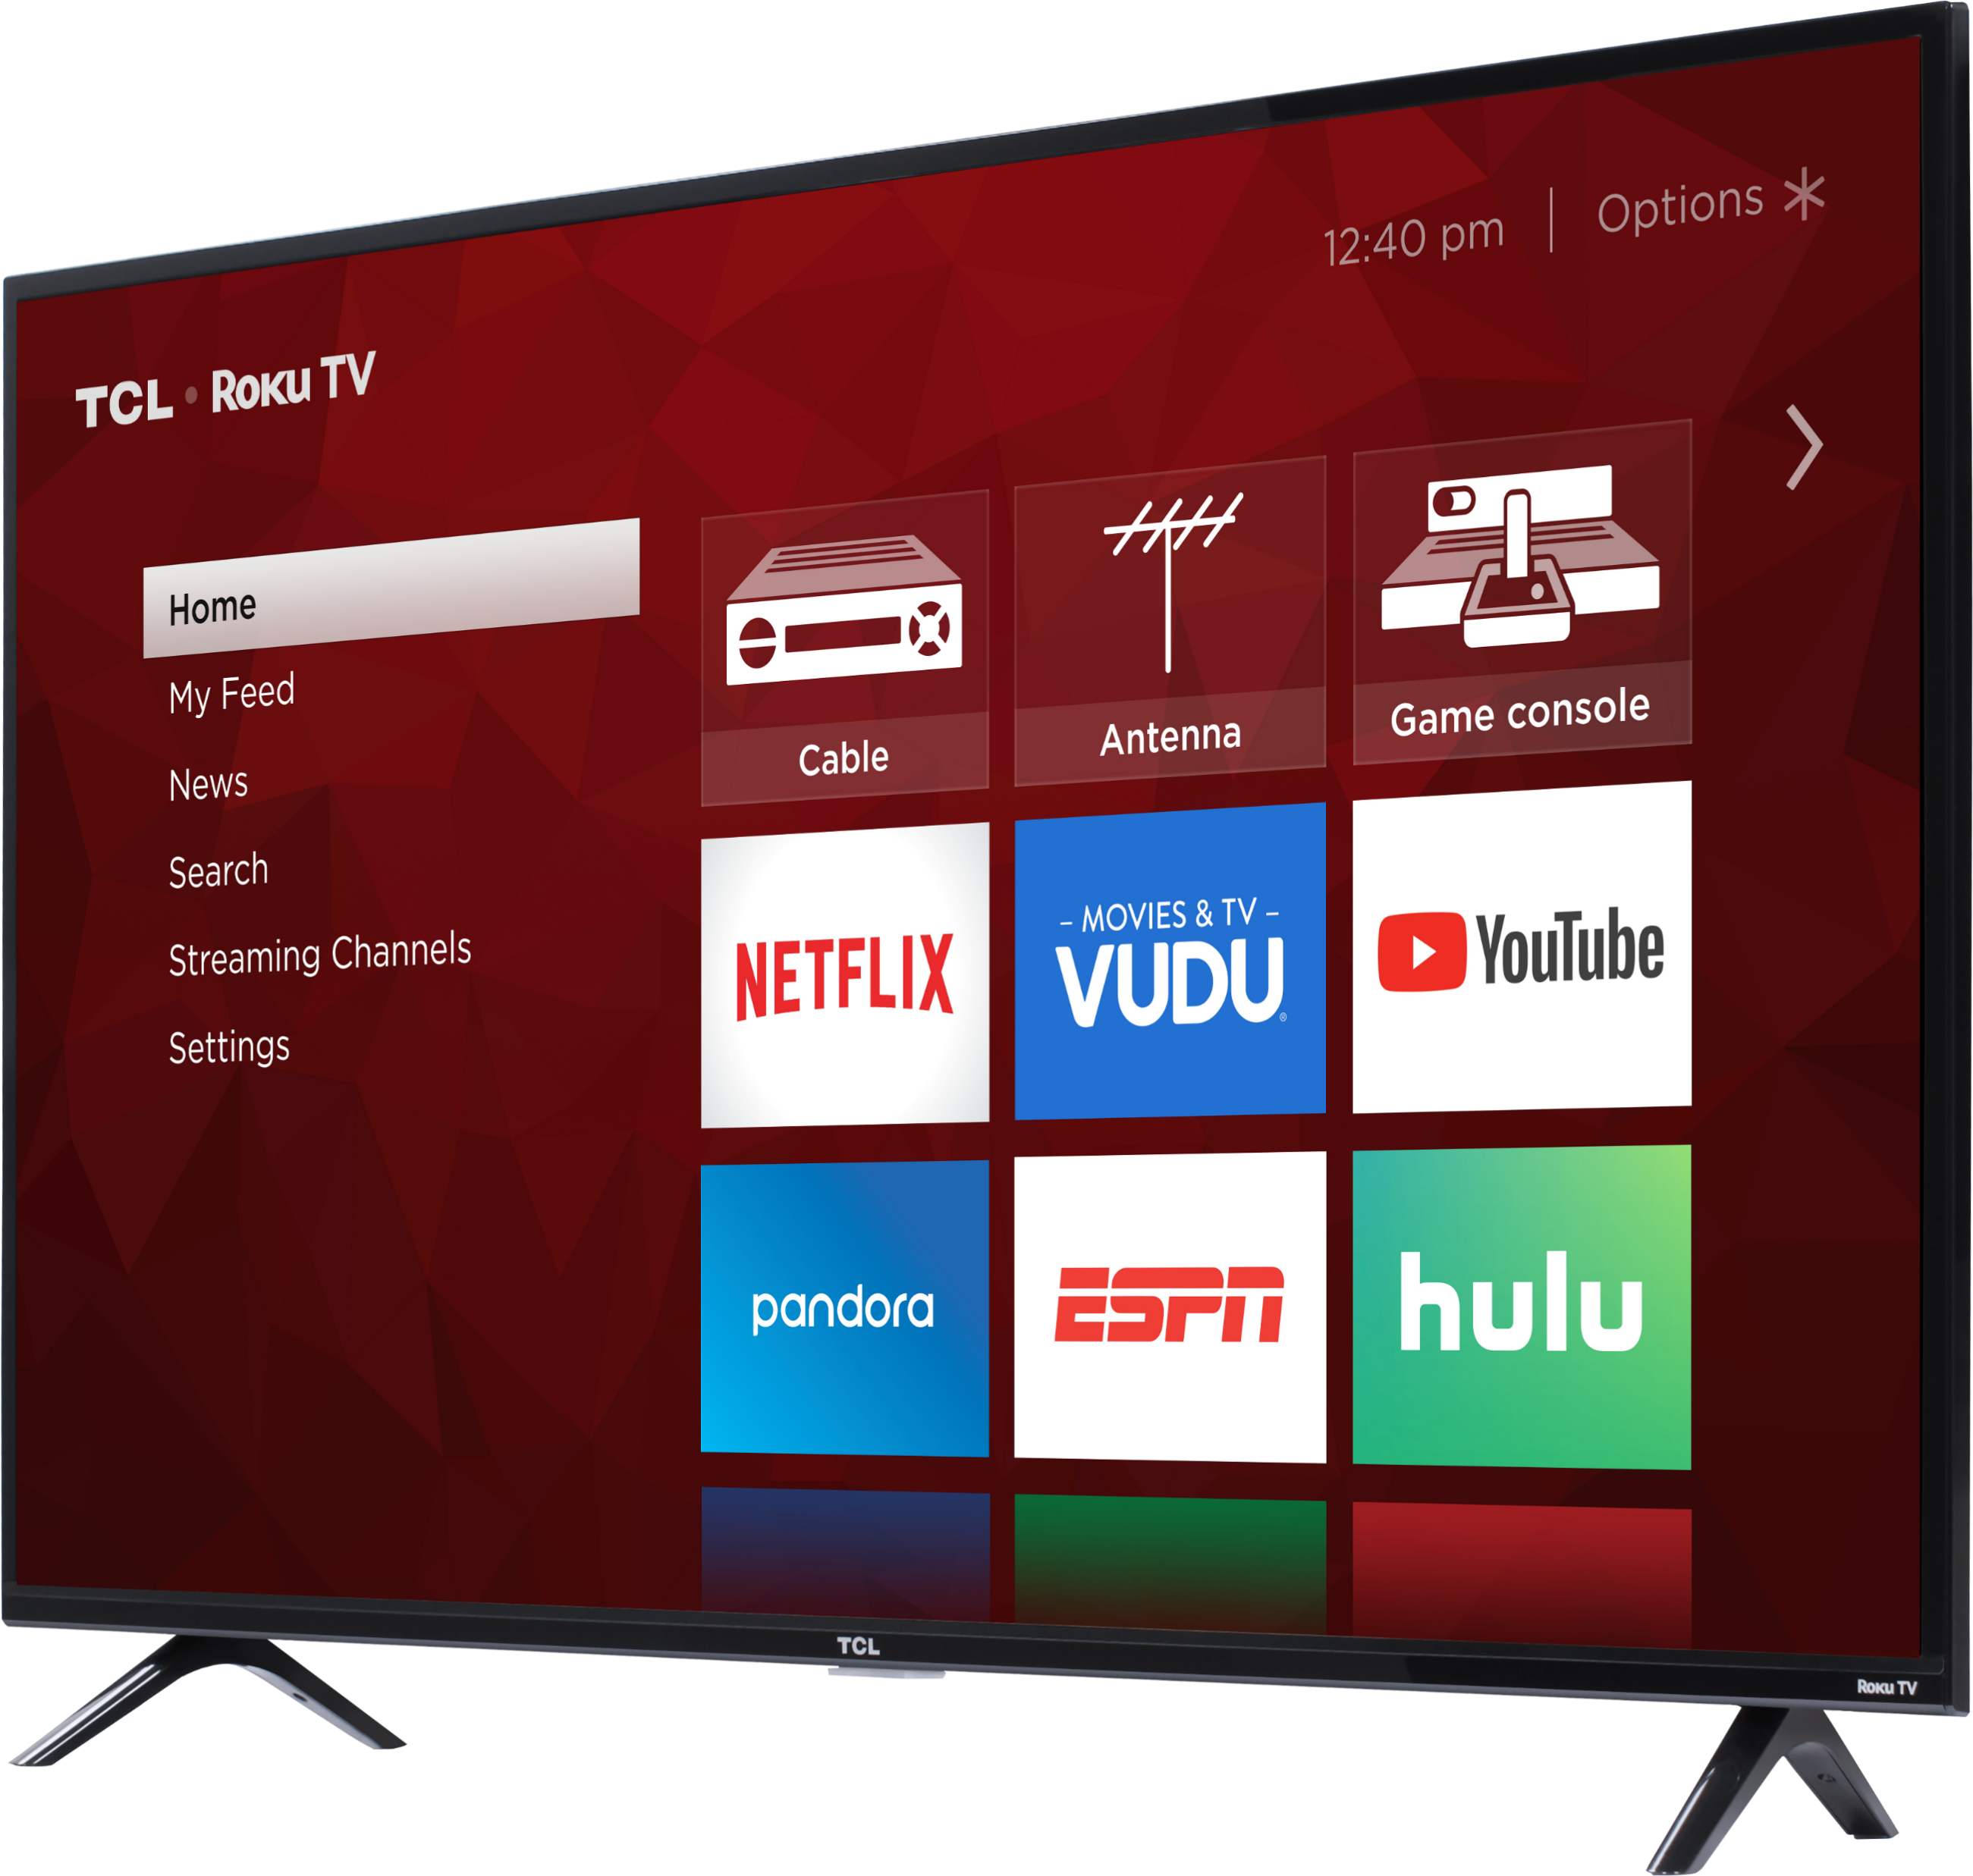
Hybrid Events – Example AV Set-up
Example set up – Laptop & TV
Notes:
In this set up, the Laptop works as the camera and microphone. The TV is the screen and speaker.
This set-up is OK if there is only one person presenting to the group at any time.

Slide 11
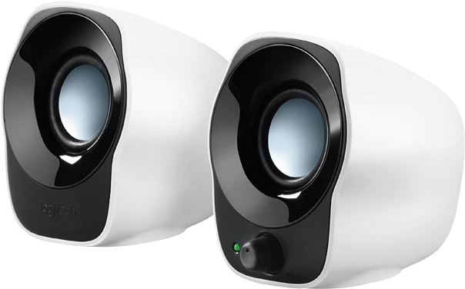
Hybrid Events – Example AV Set-up
Example set up – Laptop, TV, USB Webcam & USB Speakers
Notes:
In this set up, the Laptop is still the microphone, a screen, an external webcam (which can be rotated to focus on different speakers via the laptop) and USB speakers. Cheaper computer speaker can be used, just adjust the settings on Zoom.

Slide 12
Hybrid Events – Example AV Set-up
Example set up – Laptop, TV, USB Speakers, USB Webcam & USB Microphone
Notes:
In this set up you have the laptop, a screen, an external conference camera, USB speakers and USB conference microphone. This microphone is ‘wired’ and therefore has limited coverage.

Slide 13
Hybrid Events – Example AV Set-up
Example set – up: Laptop, TV, USB Webcam, Amplifier, Speakers, USB Receiver, Wireless Microphone & Transmitter
Notes:
In this set up you have the laptop, a screen, an external conference camera, USB speakers, wireless microphone receiver and transmitter. Great for situations where speakers are moving around. Please note there can be difficulties with connecting Bluetooth microphone via Zoom. When it comes to speakers you can’t overcome the limitations of size i.e. a small speaker can’t cover a big space without distortion. Bigger speakers tend to be passive and may need additional amplifier to improve sound quality.

Slide 14
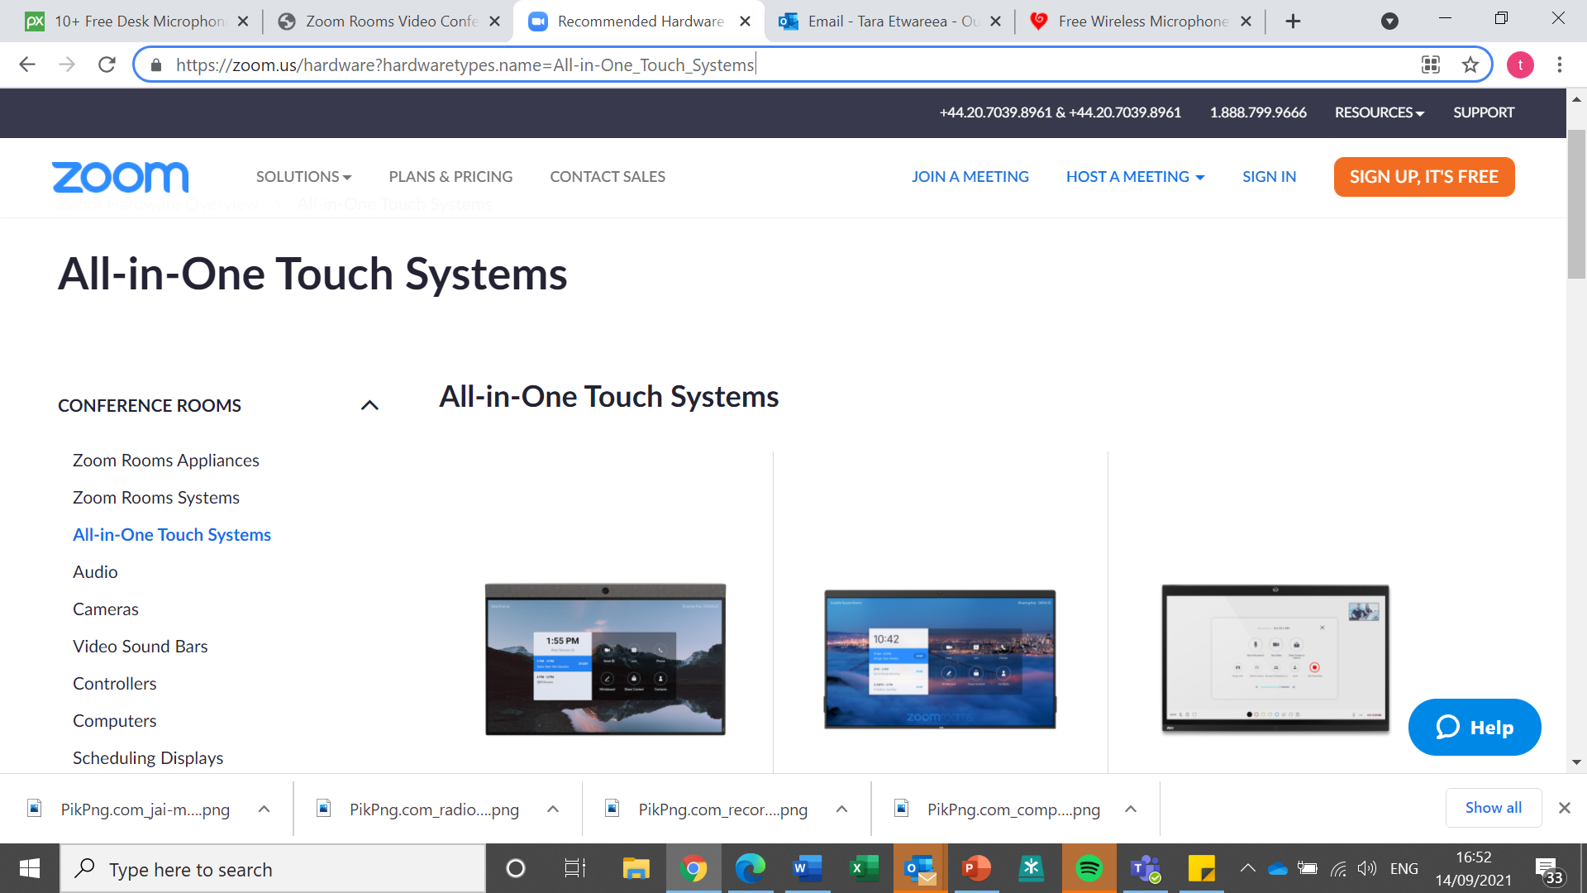
Hybrid Meetings – ‘Off The Shelf’ AV Solutions
Zoom Hardware
Some Conference Cameras
Notes:
Zoom have their own hardware available, at cost, with everything is in-built, and they are often not very portable when compared to some of the other options discussed. https://zoom.us/hardware?hardwaretypes.name=All-in-One_Touch_Systems Conference camera can be expensive but tend to be more plug and play – some automatically move around to follow speakers. Some of these come with a microphone as well.

Slide 15
Hybrid Meeting - Case study
You have a celebrity chef attending a community cooking group, and to everyone's excitement, they have agreed to make their famous signature dish.
The ingredients list was circulated online in advanced and there are 16 people in the kitchen attending in person and a further 28 joining from home.
The chef is doing almost of the speaking but will answer questions from the session attendees in the chat and in person as they go along. The chef moves around a lot and is not always facing the camera. What Microphone should you use?
A USB Microphone
A Wireless handheld Microphone
A wireless lapel microphone, transmitter and receiver

Slide 16
Hybrid Meeting - Case study
A local group are running an informal information session on a local wildlife project. They have 2 virtual speakers 5 live. They won’t be using a PowerPoint presentation and are happy to pass the laptop between each other during the session. Local residents have been invited to attend the information session and are keen to hear and see all speakers.
The venue does not provide them any equipment , the group has a low budget, and the total venue capacity is for 40 people.
What set up would you advise:
Laptop, Projector and USB speakers
Laptop, TV & USB microphone
Laptop, TV, USB Speakers & USB Webcam
Notes:
Trick question. In this example multiple set ups will work. Due to ease of transport, on this occasion, I would suggest A. the reason we added this example in is to the demonstrate the fact that sometimes the set up might not be ideal, but it can still serve a purpose.

Slide 17
Hybrid Events – A Discussion
Based on what we have just covered, in break out groups, what factors do we need to consider when planning the equipment required for a hybrid event?
Set up/testing time
What equipment is available for use at the venue
Do I have someone on site who is confident in the use of all necessary equipment
Budget
Charging of wireless equipment
The technology required for the hybrid meetings should be appropriate to the number of participants, speakers and meeting set up
Is there going to be stable internet connection
Equipment longevity – is it worth investing in equipment?
Equipment storage and transfer

